Slide 1
Making markets work for the poor
Change that matters

Slide 2
Vision and mission
Vision: We envision a world in which all we produce, and all we consume, can sustain us while respecting the planet, each other and the next generations.
Visión: Imaginamos un mundo en el que todo lo que producimos y consumimos sea sostenible, y a la vez nos respetemos unos a otros, al planeta y a las siguientes generaciones.
Mission: We bring together supply chain actors and engage them in innovative solutions to improve production, ensuring the transition to a sustainable and inclusive economy that maximizes the benefit for all.
Misión: Unimos a los diversos actores de las cadenas productivas en la definición de soluciones innovadoras para mejorar la producción, asegurando la transición a una economía sostenible e inclusiva, que maximice los beneficios para todos.

Slide 3
INDUSTRIES AND SUSTAINABILITY
Source: The 2013 Issues Survey. GlobeScan/SustainAbility.

Slide 4
Issues re. sustainability
Experts rate water scarcity, climate change and poverty as society’s most urgent challenges, with water and climate swapping places since 2011.
Ratings of the urgency of top issues have rebounded, following gradual decline since 2009.
No sector is managing the transition to sustainable development effectively. However, for the first time since 2000, experts see nearly all sectors improving incrementally.
Water scarcity is of top concern for Europeans and those in emerging markets. Concern over climate change in emerging markets trails that in North America and Europe. Notably, North Americans’ concern about climate change trumps that of other geographies.
Comparing the “urgency” and “accountability” of sustainability issues by industry may help identify areas for cross-sector collaboration.

Slide 5
Issues re. sustainability
Source: The 2013 Issues Survey. GlobeScan/SustainAbility.

Slide 6
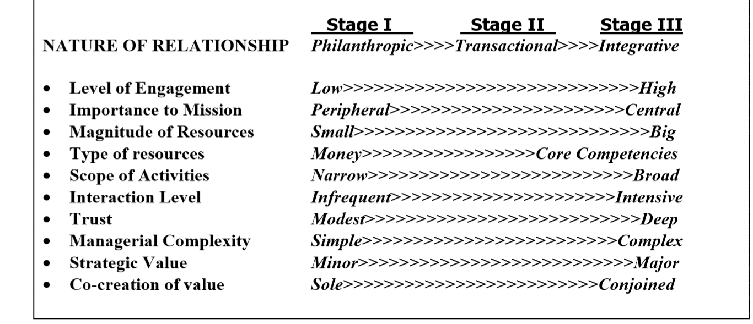
The collaboration continuum
Source: Austin, James, The collaboration challenge (2000) and other works.
Based on our experience, we pose the evolution towards the “replicative” stage, where the key actions attract new partners, be it corporate, campesino movements and public entities.
Austin proposes a fourth “stage”, the transformational, in his latest work.

Slide 7
The resiliency scheme
The concept of resiliency is useful to define two key features for enterprises’ long-term viability:
The ability to adapt, to respond to challenges and quick changes outside of the company´s control.
The continuous goal of innovation, based on a triple bottom line approach (economic, social and environmental).
(*) La resiliencia es la capacidad que tiene el emprendedor para superar situaciones que compliquen su plan de negocios o su proyecto, generando sinergia con sus socios, colaboradores y todas las partes interesadas; basado en la previsión del riesgo.
Énfasis táctico
Adaptabilidad/capacidad de respuesta
Énfasis estratégico
Capacidad de innovación en triple línea (económica, social y ambiental)

Slide 8
KEY COMMODITIES
…

Slide 9
Consumers
Companies
Sectors

Slide 10
What we propose to move forward
‘Rural Horizons’ ‘Multi certification support’ (work on the whole process, not constrained by a single “certification outcome”)
‘Landscapes of excellence’
Smart and sustainable land use
Produce more with less (ecoefficiency, etc)
Based on local/national conditions
Concentrate efforts to generate “critical mass” and “affect change” (the role of “transformation managers”):
Assure that all relevant stakeholders are “at the table”.
Adapt to local conditions.
Long-term views, based on all available scientific work.

Slide 11
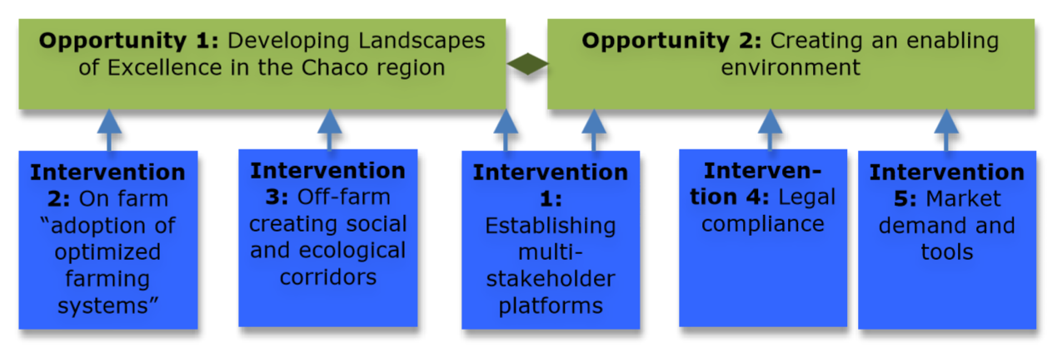
Soy and cattle, Argentinian Chaco

Slide 12
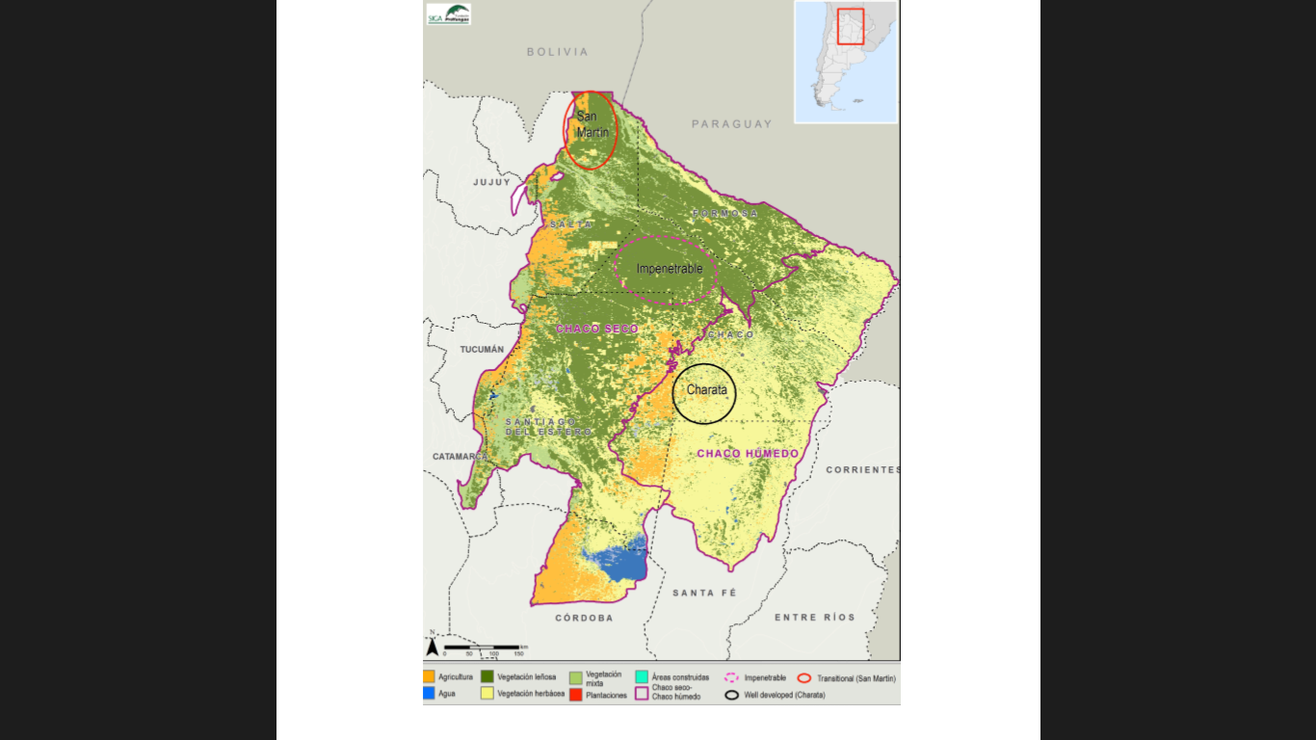

Slide 13
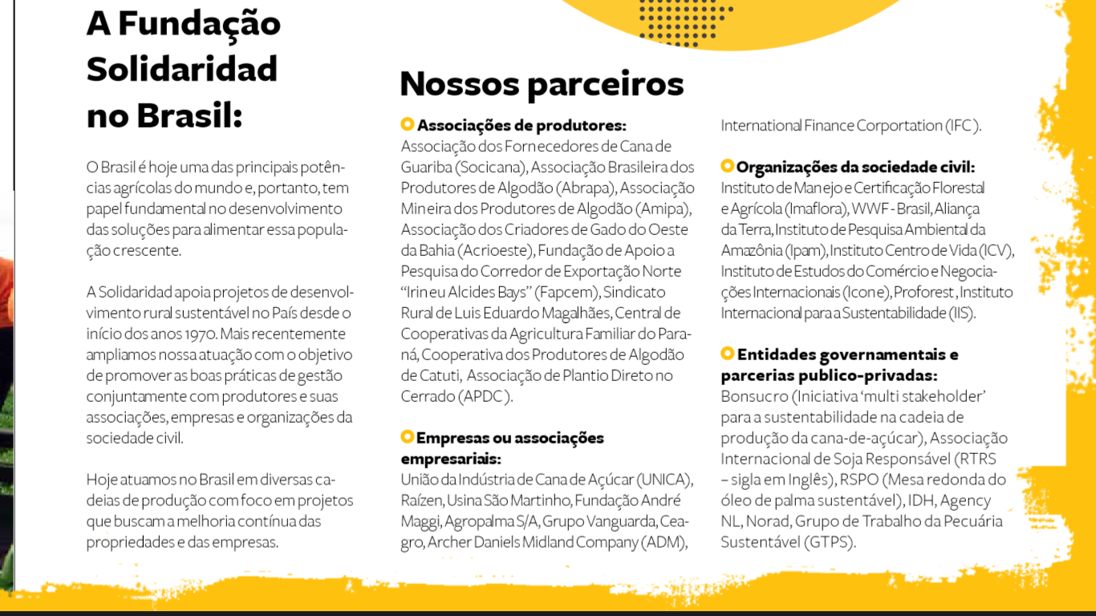
Rural Horizons, Brasil http://ruralhorizon.org/

Slide 14
A new transformational leadership(*)
A NEW TYPE OF COMPANY, FOR A NEW SOCIETY
Uma nova empresa para uma nova sociedade: ...reconhecimento de dois fenômenos: uma maior consciência das empresas sobre seu papel na sociedade e uma sociedade com demandas cada vez mais exigentes sobre a empresa.
THE ENTERPRISE AS GENERATOR OF BEHAVIORAL MODELS
Empresa como geradora de modelos de conduta: Frente ao enfraquecimento de grandes balizadores do comportamento social – Estado, família, religião – cresce em importância a responsabilidade da empresa como geradora de modelos de conduta para o conjunto da sociedade. A empresa é o que ela faz.
SOCIAL INVESTMENT AS COMPANY CORE BUSINESS
Investimento social no core business da empresa: O investimento social eficiente e sustentável requer coerência nas ações e alinhamento com o modelo de negócio da empresa e motivação de lucro.
ENTREPRENEURIAL COMPETENCE AND RESOURCES
Diferencial para a sociedade: competência empresarial e recursos: Não basta transferir recursos financeiros para a sociedade. O maior ativo das empresas é o conhecimento e a competência gerencial. É a mobilização deste ativo, aliada aos recursos, que promove impacto e sustentabilidade nas ações sociais.
FOCUS ON IMPROVING PUBLIC MANAGEMENT
Foco na melhoria da gestão pública: O maior desafio...é de como a empresa pode influir na melhoria da gestão pública. Não cabe à empresa assumir responsabilidades do Estado em áreas como educação, saúde e segurança. Mas, como parte da sociedade, transferir conhecimento, apoiar inovações e fortalecer políticas de interesse público.
(*) From a business leader, Renata Camargo(BR), Instituto de Cidadania Empresarial

Slide 15
ETHICS or ECONOMICS?:
Our main challenge is not in the realm of economics, but has to do with ethics: our purpose as human beings commanding resources, making decisions, altering natural processes, “shaping the future”.
As Bernardo Kliksberg says: Latin America has everything, so its “social debt” is inexcusable.
América Latina lo tiene todo. Cuenta con la tercera parte de la superficie disponible para el cultivo sustentable del planeta, con un tercio de las aguas limpias y con el 20% de las reservas mundiales de energía. Su producción alimentaria es fundamental para el mundo. Sus exportaciones agrícolas han crecido un 8% anual desde mediados de los 90. En aquella época representaban el 8% del comercio agrícola mundial, y hoy son el 13%...Sin embargo, a pesar de los avances, la deuda social es de mucha envergadura. Entre algunas de sus expresiones, hay más de 100 millones de personas que no tienen acceso a instalaciones sanitarias, un 50% de los jóvenes no terminan la secundaria, y más de una quinta parte de los jóvenes están fuera del sistema educativo y del mercado de trabajo.
The fundamental question is whether we will leave for the next generation to tackle the challenges that are embedded in the current possibilities or we will face them now, acknowledging that time is, probably, the greatest constraint to attain “change that matters”.

Slide 16
http://solidaridadnetwork.org/

