Slide 1
Ko ko a uka, ko ko a kai
Those of the upland, those of the shore.
-'ōlelo No'eau

Slide 2
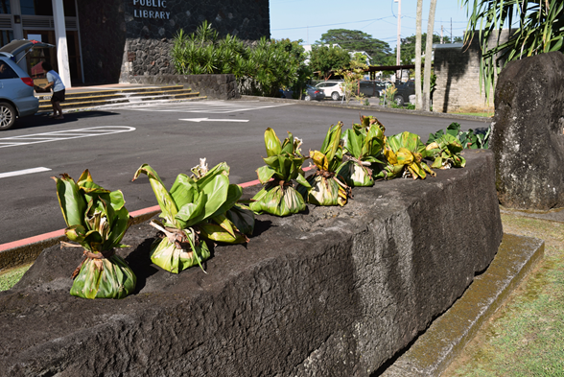

Slide 3
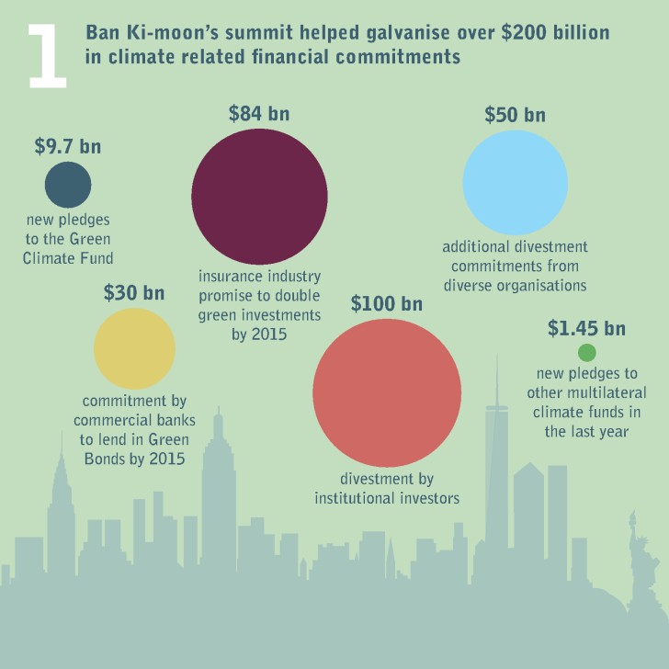
Notes:
In 2014 governments, business and the financial sector committed significant sums to help address climate change, galvanised in part by the UN Secretary General’s climate summit in New York this September. The summit refocused leaders’ attention on climate change and set the stage for major new commitments of more than $200 billion. Global efforts to divest from fossil fuels also gained momentum: the $850 million Rockefeller Brothers Fund announced that it too would divest from fossil fuels, joining a global movement that includes local governments, philanthropic foundations, universities, faith-based organisations, non-governmental organisations (NGOs) and individuals.

Slide 4
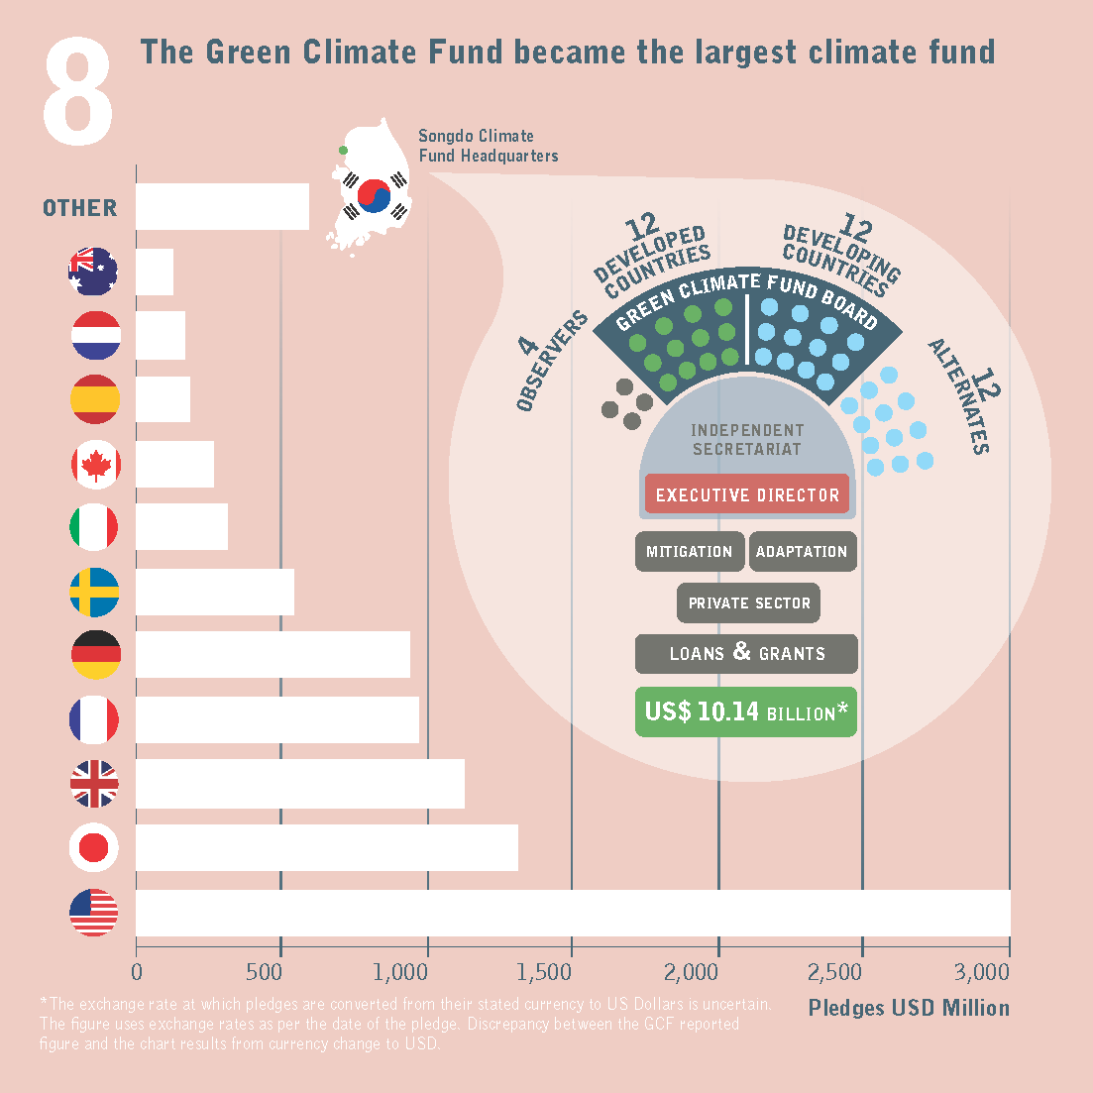
Notes:
The Green Climate Fund is now the largest and fastest-growing climate fund, with $9.7 billion pledged ahead of the Lima climate conference in December 2014. Of this the United States pledged $3 billion, Japan $1.5 billion, the UK $1.2 billion, France $1 billion, and Germany $1 billion. Developing countries also pledged support, including South Korea ($100 million) and Mexico ($10 million). As a financial mechanism of the UN climate negotiations, the speedy fulfilment of pledges will help foster trust in long-term negotiations to secure ambitious climate action. As the Green Climate Fund prepares to fund its first projects, it must build and improve on the achievements and experiences of existing fundsand set a high bar for programme implementation. To do this, it will need to find better ways to support national stakeholders and priorities; take a gender sensitive approach; and improve engagement with the private sector.
Under the oversight of the Standing Committee on Finance of the UNFCCC, the first Biennial Assessment of international climate finance identified $40-175 billion flowing from developed countries to developing countries annually between 2010 and 2012. While total climate finance flows may be falling, in 2014 multilateral climate finance increased to $2.9 billion, almost doubling the estimated average approvals of $1.5 billion a year between 2010 and 2012. Despite growing efforts to monitor climate related spending by major data providers, (the Organisation for Economic Cooperation and Development, multilateral development banks, the Climate Policy Initiative, and Climate Funds Update), huge uncertainties remain around climate-related spending. Reporting of underlying data needs to become more complete, and more precise definitions for adaptation and mitigation finance are needed.

Slide 5
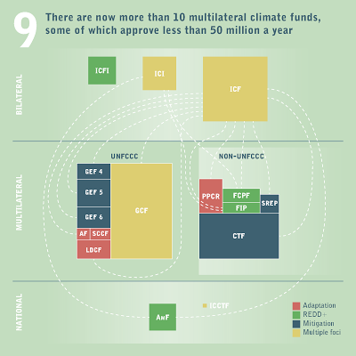
Notes:
There are more than 10 multilateral funds supporting climate action today. Smaller funds were instrumental in catalysing wider action on climate change, but there is now substantial overlap. Successful operationalisation of the Green Climate Fund (GCF)could present an opportunity to simplify, consolidate and increase efficiency, as finance scales up.

Slide 6
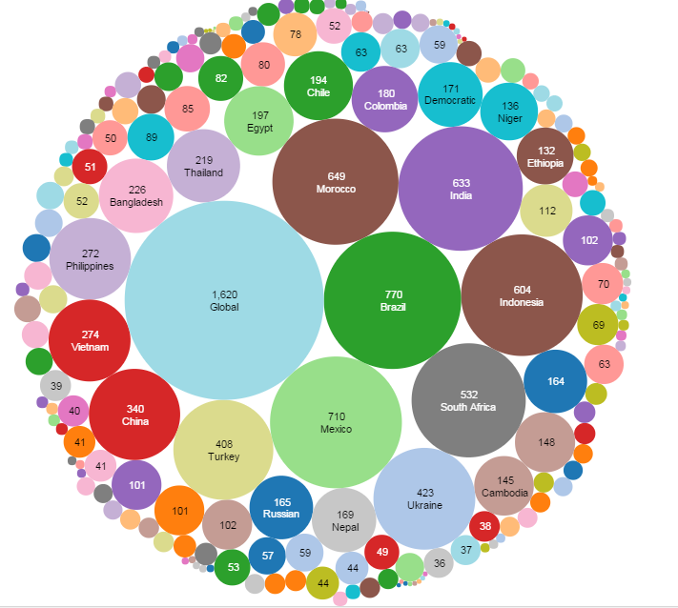
Approved Project Spending by Country (USD millions)

Slide 8
Funds in Latin American and the Caribbean (USD millions)
Notes:
Latin America is both a source of, and a sink for, carbon emissions. Growing energy demand makes many Latin American countries increasingly significant contributors to global emissions. The high level of oil production and drive to develop new petroleum resources contrasts with many governments stated intentions to pursue low carbon development. Nevertheless, there is enormous potential to implement both mitigation and adaptation activities that are compatible with sustainable development objectives. Overall, the number of climate change related initiatives across Latin America is increasing. Many countries in the region are playing a pioneering role in piloting new approaches to climate finance delivery: for example, Brazil has established an Amazon Fund to help it reduce deforestation. Finance is concentrated in a small number of countries, and in general financing for adaptation remains limited. The content on this page is taken from the Climate Finance Fundamentals publication series. Download the 'Regional Briefing - Latin America':

Slide 9
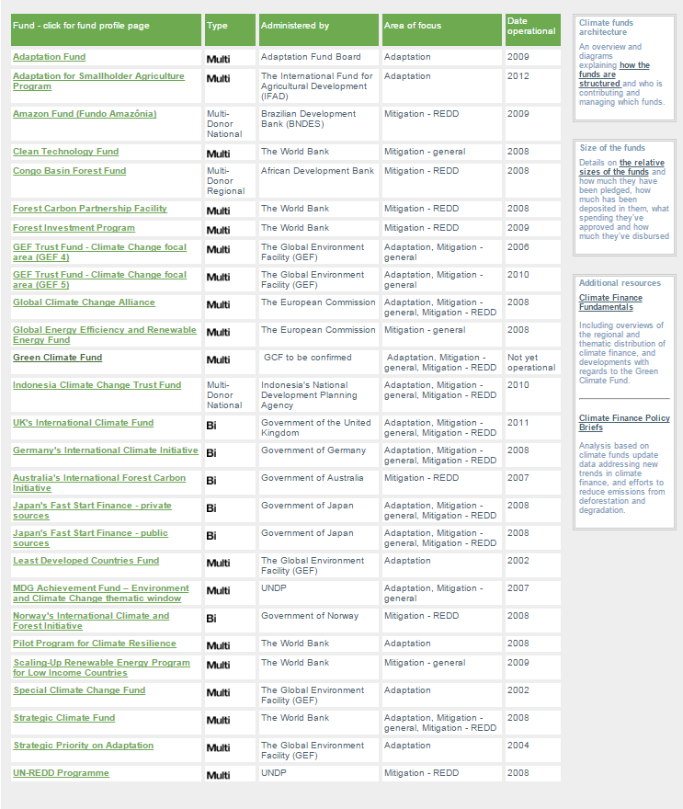

Slide 10
Potential Trends for Latin America
Overall, the number of climate change related initiatives across Latin America is increasing
So far, finance is concentrated in a small number of countries, and in general financing for adaptation remains limited (although “disaster” funding increasing)
Many countries are piloting new approaches to climate finance delivery (ex: Amazon Fund). This means opportunity for innovation but also, potentially, confusion
Funds will likely need to move quickly—from proposals to implementation; will need to move large amounts of $
Likely to prioritize layered partnerships (national/public/private/community); efforts to advance national agendas
Private sector likely to have a larger influence
Notes:
There is enormous potential to implement both mitigation and adaptation activities that are compatible with sustainable development objectives.

Slide 11
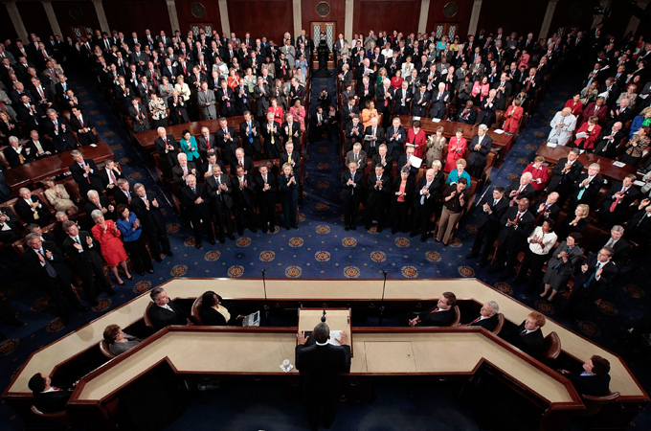
Dense bureaucracy
Project Implementers
Vast reporting (to an outside standard)
Limited understanding of Traditional Governance Systems
Notes:
Dear All,
I wanted to alert you all to a very exciting and significant funding opportunity from the European Commission (from the European Instrument for Democracy and Human Rights) on Combating Discrimination against Indigenous Peoples. As far as we know this is the first time such a fund has existed. We cannot imagine there are many organizations beyond yourselves who will be in a position to apply. It would be a great shame if the money was not well allocated, or even not allocated at all.
A total of EUR 5 million is available to support this theme; minimum grant amount will be EUR 300,000; maximum grant amount will EUR 1,000,000.
The turn-around time is sadly very quick. The deadline for the call for concept notes (and, a 48 page application) is 8 August 2013. Yes, this just a concept note. A timetable for notification if you are invited to submit a full proposal has not yet been established but updates will be posted here: https://webgate.ec.europa.eu/europeaid/online-services/index.cfm?do=publi.welcome
Other items to consider: Jean-Louis Ville, Head of Unit, Governance, Democracy, Gender and Human Rights for the European Commission was at the Alta Preparatory Meeting in an effort to learn and prepare more for this process. DoCip connected us with him there. Ken Wilson, our Executive Director, had a long conversation with him and was very encouraged. They talked about the value of co-funding so those of you who have grants from us or similar foundations can please refer to our support as co-funding and we can write to Jean-Louis in support of your application.
I think it’s fair to say that the Unit is learning about how indigenous peoples and their organizations work but seems very open. Some of you may have experience with the challenges as well as pleasures of EU funding of this type.
The application is very dense. I tried to pull out very basic information to help you begin to navigate the application. Full application guidelines can be found here (https://webgate.ec.europa.eu/europeaid/online-services/index.cfm?ADSSChck=1372782353294&do=publi.detPUB&searchtype=AS&Pgm=7573843&zgeo=38220&debpub=&orderby=upd&orderbyad=Desc&nbPubliList=15&page=1&aoref=134379). Please distribute as appropriate.
Best of luck!
China
DESCRIPTION:
LOT 1 - Discrimination against Indigenous Peoples
The principles of the EU engagement towards indigenous peoples are applied in the context of the Council Resolution on Indigenous Peoples of 30 November 1982 and the Council Conclusions on Indigenous Peoples of 18 November 2002. Both documents respond to the ILO Convention No.169 of 1989 on Indigenous and Tribal Peoples, and more recently, to the UN Declaration on the Rights of Indigenous Peoples of 2007 (UNDRIP), which advance the rights and ensure the continued development of indigenous peoples around the world. In recent years, Indigenous Peoples from different parts of the world have been victims of persecution, illegal detentions, threat and even extra-judicial killings either by private security groups or by members of the local police or military forces. Indigenous Peoples’ efforts to defend their territories and the environment from aggressive industrialisation have resulted in strong repression. At the same time, various violations of human rights are being perpetrated against them, especially violations of the right to free, prior and informed consent to lands, territories and their resources (together with the right of freedom of expression) and to self-determination. In many countries, indigenous peoples have no access to political and civic participation because of twisted and restrictive laws. In other places, indigenous peoples simply don’t have access to education, not only because they live in remote areas, but mainly because their ethnic origin, cultural values and customs, are different from the mainstream society they live in, provoking a loss of cultural identity and risking the extension of poverty and exclusion.
The specific objective of this Lot is to combat all forms of discrimination against indigenous peoples, through Actions such as: to improve their social, economic and political participation; to support free, prior and informed consent in decision making processes; to promote dialogue with authorities on access to land and their natural resources; to protect them from violence and criminalization; to ensure access to justice, etc. (Non-exhaustive list).
AMOUNT AVAILABLE:
EUR 5 million available
Minimum grant amount: EUR 300,000
Maximum grant amount: EUR 1,000,000
EU contribution could cover up to 95 % of the total eligible costs of the action (see also Section 2.1.4). The balance (i.e. the difference between the total cost of the action and the amount requested from the Contracting Authority) must be financed from sources other than the European Union Budget or the European Development Fund.
DEADLINE:
8 August 2013 (Brussels' date and time)
The deadline for the submission of applications will be indicated in the letter sent to the applicants whose application has been pre-selected. Any Full Application Form sent after the deadline will be rejected. However, for reasons of administrative efficiency, the Contracting Authority may reject any application sent in due time but received after the date of approval of evaluation report for full applications (see Section 2.5.2).
Applicants are strongly advised not to wait until the last day to submit their Full Applications, since heavy Internet traffic or a fault with the Internet connection (including electricity failure, etc.) could lead to difficulties in submission. The EC cannot be held responsible for delay due to such afore-mentioned difficulties.
ELIGIBILITY CRITERIA:
Eligibility of applicants (i.e. applicant and co-applicant(s))—i.e. collaborating partners or community-based organizations/community groups in the country of grant operation
Applicant
(1) In order to be eligible for a grant, the applicant must
• be a natural person or an entity without legal personality5 or
• be a legal person and
• be non-profit-making and
• be specific types of organizations6 such as civil society organizations, including non-governmental
organizations and independent political foundations, community based organizations, and private sector
agencies/institutions/organizations, and their networks7. and
• be directly responsible for the preparation and management of the action with the co-applicants and, if
any, affiliated entity(ies), not acting as an intermediary.
No nationality restriction applies to applicants, co-applicants and, if any, affiliated entities, even if priority will be given to projects submitted by applicants from Countries listed in Annex I so as to promote ownership and strong local leadership. Regardless of the applicant’s nationality, applicant must act with at least two co-applicants per involved country. Exceptionally, where an applicant considers that an action carried out with any local co-applicants is not feasible or appropriate due to the specific constraints, duly justified reasons must be provided. These reasons will be examined in the context of the evaluation.
RULES FOR THIS CALL FOR PROPOSALS:
These guidelines set out the rules for the submission, selection and implementation of the actions financed under this Call, in conformity with the Practical Guide to contract procedures for EU external actions, which is applicable to the present call (available on the Internet at this address: http://ec.europa.eu/europeaid/work/procedures/implementation/index_en.htm).

Slide 12
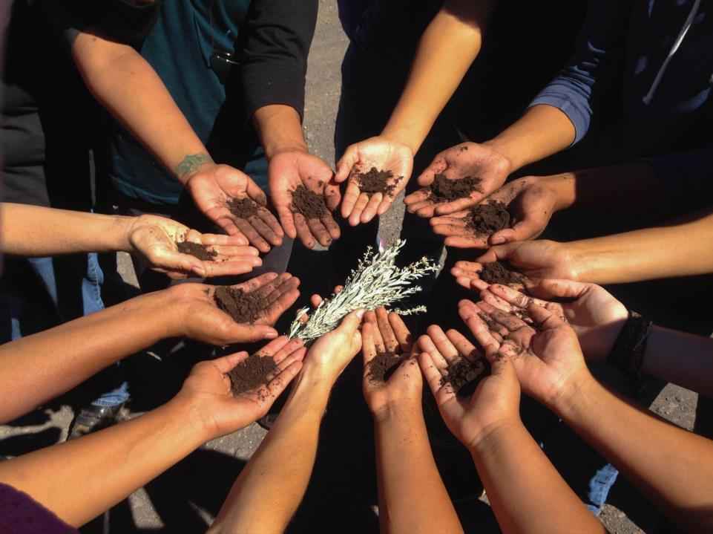
Take a minute to think about the best grant you/your community has ever received?
What made it memorable?
What made effective?
What made this grant stand out?
Now, think about the grant thru the entire grantmaking process:
How did you find out about the funds?
Applying
Receiving Funds
Implementing a vision
Reporting
Long-term Impact/Community Relationships

Slide 13
Recognizable (Higher Success/Sustainable)
Inclusive
Flexible Budget
Timeline
Implementation
Built/Informed Community Assets
Increased Relationships

Slide 14
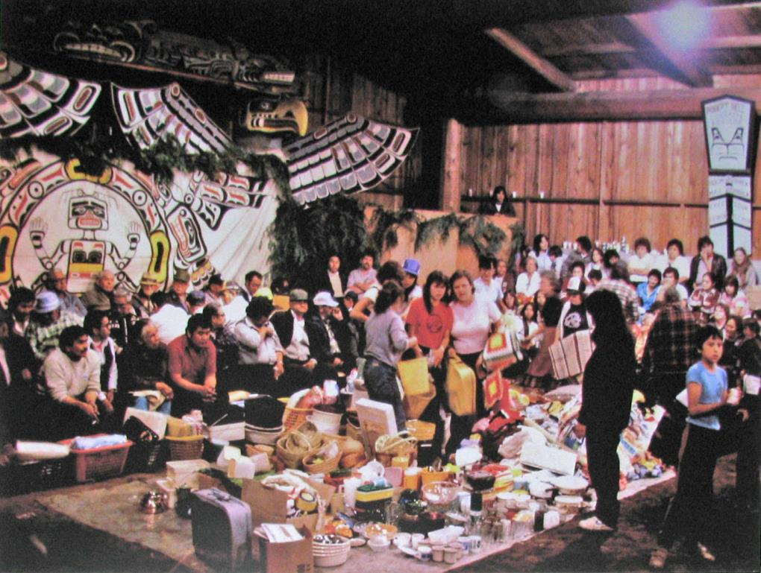

Slide 15
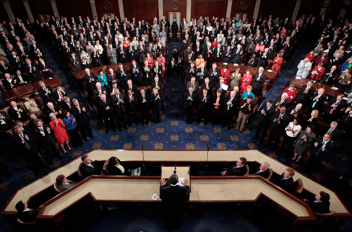
How are these processes developing simultaneously and in mutually beneficial ways?

Slide 16
How are resources developing simultaneously and in mutually beneficial ways?
How are creating the narrative around resources?
How are you building/promoting your vision of long-term resilience? How are you communicating this to outsiders? To potential partners?
How are you building relationships?
How are you utilizing more flexible funds in ways which augment more restrictive funds?
How are you preparing for a time when big climate funds wane/shift?

Slide 17
Mahalo nui loa

Slide 19
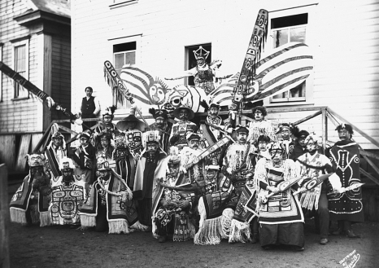
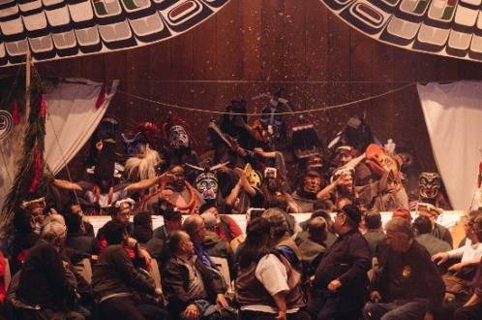
Notes:
Aishihik First Nations
A potlatch is a gift-giving feast practiced by indigenous peoples of the Pacific Northwest Coast of Canada and the United States, among whom it is traditionally the primary economic system. This includes the Heiltsuk, Haida, Nuxalk, Tlingit, Makah, Tsimshian, Nuu-chah-nulth, Kwakwaka'wakw, and Coast Salish cultures.

Slide 20
Green Climate Fund (GCF)
How as a community, are you thinking pro-actively about engaging in these Global Funds?
Notes:
The lack of pledged funds and potential reliance on the private sector is controversial and has been criticized by developing countries.^{[11]}
Pledges to the fund reached $10.2 billion on May 28, 2015.^{[12]}
Using the money in the right way in order to enforce actual change on the ground is one of the biggest challenges ahead. Many academics argue that, in order to do this in an efficient way, all stakeholders should be involved in the process, instead of using a top-down approach. They point to that fact that, without their input, it is harder to achieve targets set. Moreover, projects often even miss out on their actual purpose.[18][23][24][25][26] A group of researchers associated with the Australian National University,[27] call for the foundation of so-called ‘National Implementing Entities’ (NIE) in each country, that would become responsible for ‘the implementation of sub-national projects’.[27] This would avoid national governments getting too involved, because in the past, they ‘often hindered the flow of international support to subnational scale reform for sustainable development’.[27] Overall, this view on the need for more stakeholder involvement can be framed within the movement in environmental governance calling for a shift from traditional ways of government to governance.[28] The Climate & Development Knowledge Network is funding a research project that aims to help the GCF Board, by analysing how best to allocate resources among countries. The project will research and present four case studies of how federal or central government money is presently distributed to sub-national entities. Chosen for the diversity in their underlying political systems, these are: China, India, Switzerland and the USA.[29]

Slide 21
Green Climate Fund (GCF)
a fund within the framework of the UNFCCC founded as a mechanism to assist developing countries in adaptation and mitigation practices to counter climate change. The GCF is based in the new Songdo district of Incheon, South Korea. It is governed by a Board of 24 members and initially supported by a Secretariat.
It is intended to be the centrepiece of efforts to raise Climate Finance of $100 billion a year by 2020
They identified the need to assess various options for how nations could access the fund, approaches for involving the private sector, plus ways to measure results and ensure requests for monies are country-driven
http://www.climatefundsupdate.org/the-funds
Notes:
The lack of pledged funds and potential reliance on the private sector is controversial and has been criticized by developing countries.^{[11]}
Pledges to the fund reached $10.2 billion on May 28, 2015.^{[12]}
Using the money in the right way in order to enforce actual change on the ground is one of the biggest challenges ahead. Many academics argue that, in order to do this in an efficient way, all stakeholders should be involved in the process, instead of using a top-down approach. They point to that fact that, without their input, it is harder to achieve targets set. Moreover, projects often even miss out on their actual purpose.[18][23][24][25][26] A group of researchers associated with the Australian National University,[27] call for the foundation of so-called ‘National Implementing Entities’ (NIE) in each country, that would become responsible for ‘the implementation of sub-national projects’.[27] This would avoid national governments getting too involved, because in the past, they ‘often hindered the flow of international support to subnational scale reform for sustainable development’.[27] Overall, this view on the need for more stakeholder involvement can be framed within the movement in environmental governance calling for a shift from traditional ways of government to governance.[28] The Climate & Development Knowledge Network is funding a research project that aims to help the GCF Board, by analysing how best to allocate resources among countries. The project will research and present four case studies of how federal or central government money is presently distributed to sub-national entities. Chosen for the diversity in their underlying political systems, these are: China, India, Switzerland and the USA.[29]

Slide 22
Recognizable (Higher Success/Sustainable)
Inclusive
Flexible Budget
Timeline
Implementation
Built/Informed Community Assets
Increased Relationships

