Slide 1
Governance and Territorial Coalitions in El Salvador: Creating Responses to the Economic Crisis and Climate Change.
Ileana Gómez Galo
Fundación Prisma.
.
XIII World Congress of Rural Sociology.
The New Rural World.
July 29 to August 4, Lisbon, Portugal

Slide 2
Startig point
Rural areas of Central America are changing their territoriality due to changes in the economic and climate change: land use, new foreign investments, conflicts, food insecurity.
The poor and environmentally vulnerable territories can generate practices and policies that deepen democracy and encourage territorial dynamics to move towards economic distribution of assets, diversification of production options, management of environmental vulnerabilities and even promote a strategic vision of territorial development.
Participation in regional coalitions provides capabilities to respond to these changes: building endogenous development proposals, definition of territorial strategies, policy advocacy and conflict management.

Slide 3
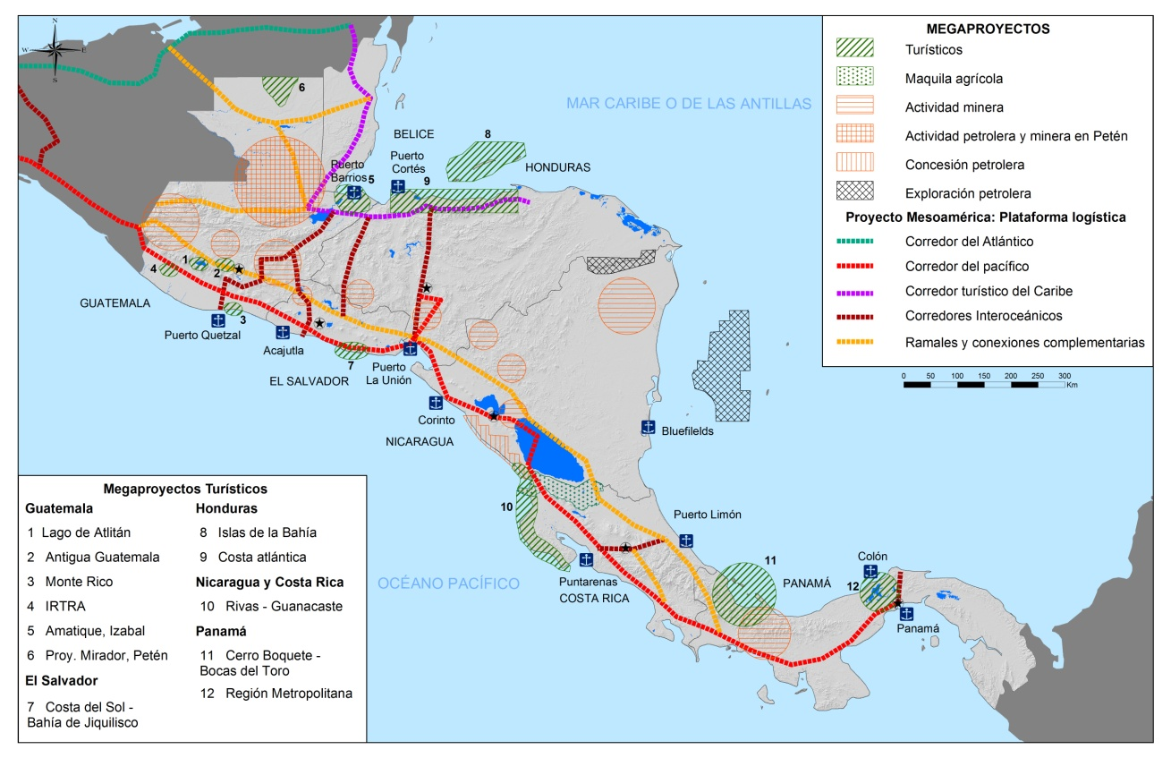
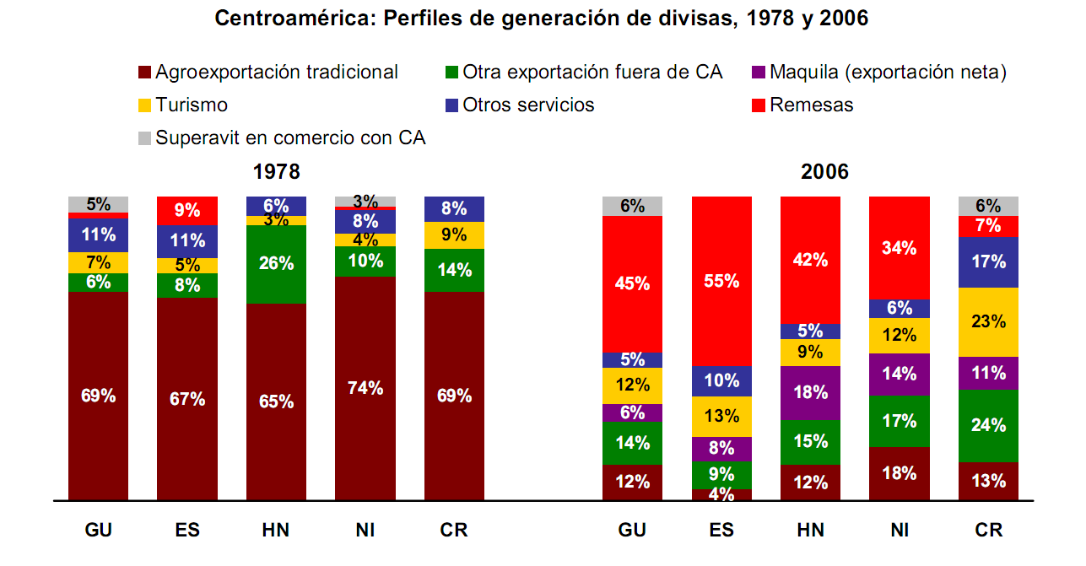
The context: Economic Change in Central America
Diversification and economic growth in Central America: expansion of nontraditional crops (pineapple, orange, oil palm, intensification of sugarcane), services, mining, oil exploitation and tourist investments.
Central American Logistic Corridor: economic channel aimed at turning the region into an area of world-class logistic activity, through an infrastructure program and the development of facilities and logistic services favoring international trade.
Source: Cuellar et al, Fundación Prisma (2012).
El Salvador economy has quickly moved away from its traditional agro-export (coffee, sugar cane and cotton) - to one of expanding services, including a dynamic maquila textile sector and remittances.
El Salvador is the country with less foreign investment in Central America has made ​​economic growth and investment to GDP below the average of the Americas and Asia (CEPAL 2010).

Slide 4
The context: Climate Change
Central America Countries with High Vulnerability Based on Economic Risk to GDP from Two or More Hazards
Tropical cyclones and low pressure systems that caused torrential rains in El Salvador 1961-2011
Country | Percent of total area at risk | Percent of population area at risk | Percent of GDP in areas at risk
El Salvador | 88.7 | 95.4 | 96.4
Guatemala | 52.7 | 92.1 | 92.2
Costa Rica | 51.9 | 84.8 | 86.6
Nicaragua | 21.6 | 68.7 | 67.9
Honduras | 19.0 | 56.0 | 56.5
From the Pacific Ocean
From the Atlantic Ocean
Source: World Bank, 2006
Source: Ministry on Environment and Natural Resources (MARN).
Extreme events such as hurricanes and tropical storms intensify and increase their frequency in the Caribbean basin and Central America (IPCC).
The impacts of climate change threaten the future of development in Central America region highly exposed and vulnerable because of their socioeconomic status.
El Salvador is an extreme case. The increase of extreme events from the Pacific Ocean has increased the economic and human damage: E96/Ida (2009), Agatha (2010) and DT12E (2011) left a total of 244 people died and losses of U.S. $ 1.300 million.

Slide 5
Responses from public policy
Promoting economic change in a economically stagnant country:
North American cooperation policies in El Salvador to promote economic recovery: FOMILENIO II for the development of the Coast Zone (U.S. $ 300 million) supported by the Millennium Challenge Corporation. Focused on creating conditions to promote private investment.
“Partnership for Growth Program” (Obama´s initiative): report on the obstacles to economic growth in El Salvador, pointing to two binding constraints to growth: the violence and insecurity and low productivity in the tradeable sector.
The scenario of development in El Salvador combines three key elements: territory, private investment and addressing social and environmental vulnerabilities especially related to climate change.
Institutional transformation to address climate change:
The State recognizes: "environmental degradation and climate variability are an obstacle to improving the quality of life and build a robust economy, competitive, able to grow and create quality jobs." (National Environmental Policy)
Actions to adapt the social and productive infrastructure to climate change: Ministry of Public Works create the Climate Change Adaptation and Strategic Risk Management Department.
Reorientation of public finances: IDB approved a loan of $ 200 million under the “Program for Fiscal Sustainability and Climate Change Adaptation”: institutional strengthening and policies for climate change adaptation and risk management.

Slide 6
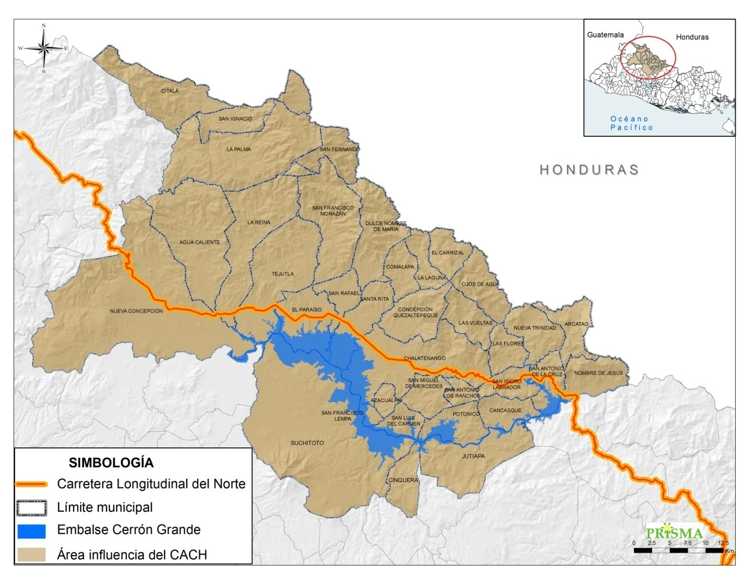
Territorial Dynamics in Chalatenango-Cerrón Grande
Provided workforce for the agro-export model.
Predominance of subsistence agriculture on hillsides.
Strong campesino organizations during the seventies.
Civil war and economic crisis produce population displacements, migrations and repression.
Provides important ecosystem services: Hydroelectric energy.
Regional coalitons were formed during the pos war reconstruction, definined the endogenus vision of development.
Connectivity route: Carretera Longitudinal del Norte.

Slide 7
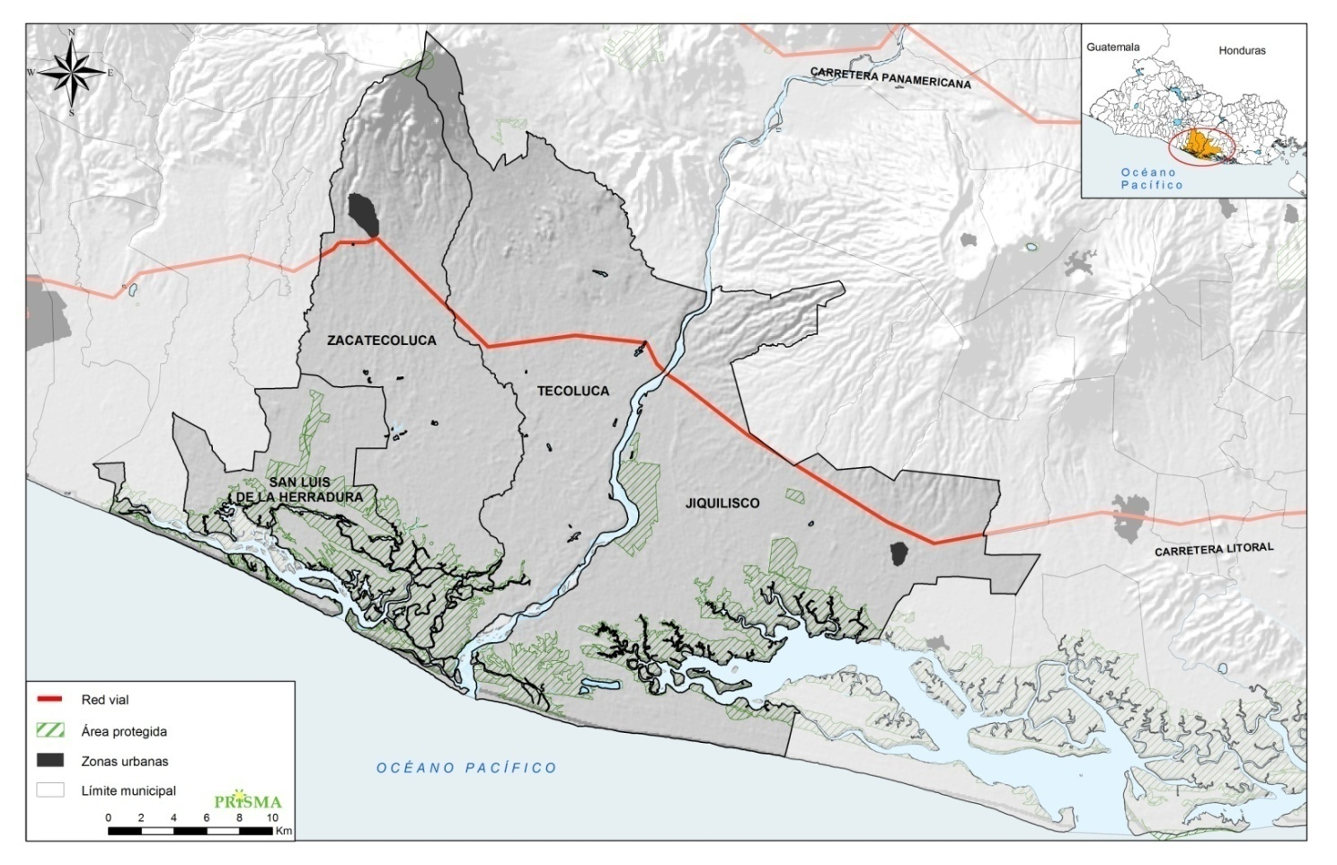
Territorial Dynamics in Bajo Lempa
Large farms expand cotton crop in forest areas and mangroves: demand temporary workforce, use of pesticides and agrochemicals.(40´s-60´s) .
Expropriation of large farms by land reform and agricultural cooperative training.
Civil War produce abandon and resettlement of the region.
High vulnerability to flooding.
Strong social organizations develop communitarian production and local system of risk management.
Territorial Coalitions: risk management, Strategic plan for territorial development
Environmental Policys: Biosphere Reserve of the Bahía de Jiquilisco.
Development Policys: FOMILENIO II.

Slide 8
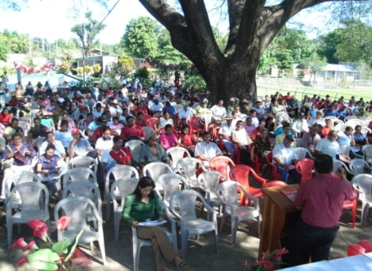
Building territorial governance in times of economic change and climate change.
Local governance: ways in which public actors, communities and organizations work together to define policy priorities.
Distribution of resources, build strategies of short and medium term priorities and establish regulations for access and use of key natural resources for their livelihoods: water, wood, access to farm land.
System of local organization (national and international support,) leading postwar reconstruction, focuses on ensuring the basis of household production for food security, productive development and management of disaster risks.
Territorial coalitions define strategies (medium to long term) and negotiation of interest facing the State.

Slide 9
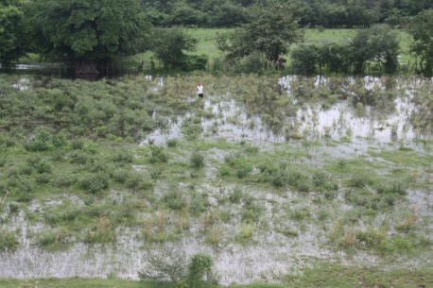
Local organization for food security, productive development and management of disaster risk
Local community-based organization promotes local development.
Policy framework for reconstruction and decentralization (Peace Accords, 1992): Distribution of land (PPT), expanding political participation (FMLN Party).
Support networks: ideological (organization, leadership, community values​​, gender); technical(organic agriculture, farms plans, agroforestry, production chains) and measures to adapt to climate change and of mitigating its effects (crops adapted to rain, restoration of mangroves, local early warning systems, home modification, and strengthening retaining walls)
Achievements: culture of participation, land tenure security, basis for food security, alternative products (organic products).
Community values ​​guide the local governance: equity, environmental sustainability and solidarity based economy.

Slide 10
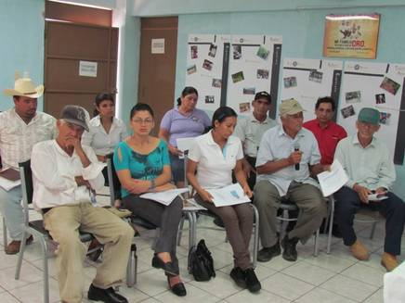
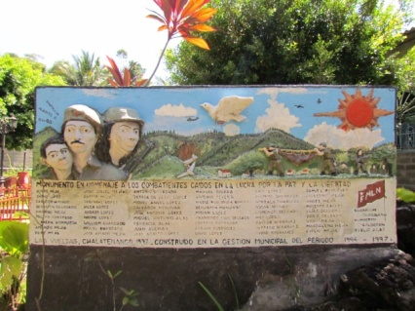
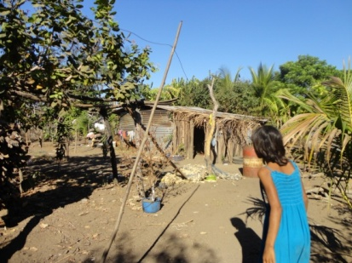
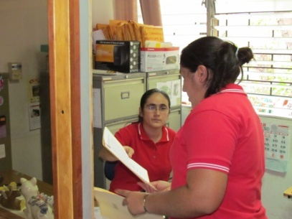
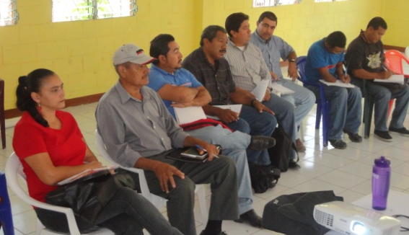
Territorial Coalitions
“The convergent action of a number of different actors around territorial development dynamics, located in a medium and long term”
a) territorial level: network of social relations and institutional arrangements.
b) transformative role of institutions or common sense for change economic, social and political.
(Fernández et al.,2012)
Address critical issues of livelihoods to ensure the basis of reproduction, and common problems: natural resource management and risk management.
Define their own territorial project: PADEMA, Strategic plan for territorial development of Bajo Lempa.
Formed by community-based organizations, farmers' and fishermen's organizations, women's organizations, local technicians, municipalities, representatives of government, local NGO's, etc.
Broad political action: mobilizing resistance to dams, mining, sugar cane expansion; conflict negotiation; incidence in public policies.
High coordination capacity and cooperation, have more access to social resources of the territorial network, access to clue information and political influence.
Government partners in implementing programs and projects (FOMILENIO II, National Program of Restoration of Ecosystems and Landscapes, Wetlands Management Program, etc).
Promote local leadership.

Slide 11
CONCLUSIONS
The strength of these cases to address the adverse context of social and environmental poverty and vulnerability is in its social capital and the strategies to improve access to other assets such as natural resources, human capital or infrastructure.
Limits: high degradation, legacy of neglect of agricultural and rural development policies, economic stagnation, scarcity of funds for investment in agricultural production projects.
The high vulnerability to climate change deepens its limitations, but also generates new adaptive strategies.
Current territorial development policies can open new generation of relationships between these territories and the state to enhance their local achievements

