Slide 1
Livelihoods, migration and adaptation to climate change
Ben Orlove
Columbia University
Migration, Rural Livelihoods and Natural Resource Management
PRISMA workshop
February 2011

Slide 2
Overview
A brief exploration of the guiding concepts of the conference
Migration
Rural Livelihoods
Natural Resource Management
How do these three concepts interact with economic, social and environmental frameworks?
What guidance does this interaction give us for considering migration as an adaptation to climate change?

Slide 3
Overarching theme: space
 |  | Migration | Livelihoods | Natural resource management
Space and nature | environment
Space and value | economics
Space and governance | society

Slide 4
Overarching theme: space
 |  | Migration | Livelihoods | Natural resource management
Space and nature | environment | Movement
Space and value | economics | Income flows
Space and governance | society | Networks Citizenship

Slide 5
Overarching theme: space
 |  | Migration | Livelihoods | Natural resource management
Space and nature | environment | Movement
Space and value | economics | Income flows
Space and governance | society | Networks Citizenship
Alternate concepts |  | Mobility

Slide 6
Overarching theme: space
 |  | Migration | Livelihoods | Natural resource management
Space and nature | environment | Movement
Space and value | economics | Income flows
Space and governance | society | Networks Citizenship
Alternate concepts |  | Mobility Refugees

Slide 7
Overarching theme: space
 |  | Migration | Livelihoods | Natural resource management
Space and nature | environment | Movement | Resources
Space and value | economics | Income flows | Income Property
Space and governance | society | Networks Citizenship | Households Communities

Slide 8
Overarching theme: space
 |  | Migration | Livelihoods | Natural resource management
Space and nature | environment | Movement | Resources
Space and value | economics | Income flows | Income Property
Space and governance | society | Networks Citizenship | Households Communities
Alternate concepts |  | Mobility Refugees | Well-being Security Vulnerability

Slide 9
Overarching theme: space
 |  | Migration | Livelihoods | Natural resource management
Space and nature | environment | Movement | Resources | Sustainable management
Space and value | economics | Income flows | Income Property | Ecosystem services
Space and governance | society | Networks Citizenship | Households Communities | Commons State control

Slide 10
Overarching theme: space
 |  | Migration | Livelihoods | Natural resource management
Space and nature | environment | Movement | Resources | Sustainable management
Space and value | economics | Income flows | Income Property | Ecosystem services
Space and governance | society | Networks Citizenship | Households Communities | Commons State control
Alternate concepts |  | Mobility Refugees | Well-being Security Vulnerability | Post-consumerismDeep ecology

Slide 11
Livelihoods, migration and adaptation to climate change
How well do the following concepts fit together?
Livelihoods
Migration
Adaptation to climate change
Let’s look at them two at a time.

Slide 12
Livelihoods, migration and adaptation to climate change
Migration and livelihoods
Migration is a part of many livelihood strategies.
Many livelihood systems involve multiple activities in different locations, to optimize resource use and to reduce risk.
This could be called mobility as well as migration.
Patterns of mobility around the world are often very old, and structured in culturally distinctive ways.
E.g., Pacific Islands, High Arctic, indigenous Andes

Slide 13
Livelihoods, migration and adaptation to climate change
Livelihoods are an important part of adaptation to climate change.
Climate change impacts livelihoods through:
Gradual shifts in climate, water availability, sea level, vegetation and human health which alter productivity (trends)
Increased hazards (extreme events)
Changing livelihoods can constitute adaptations to climate change, by allowing people access to resources to complement the ones that are impacted.

Slide 14
Livelihoods, migration and adaptation to climate change
If migration can be part of livelihoods
And livelihoods can be a part of adaptation to climate change,
Can migration be part of adaptation to climate change?

Slide 15
Can migration be part of adaptation to climate change?
Reasons for saying yes:
Migration can allow access to resources to complement the ones that are lost because of changing trends or extreme events.
Many people are used to mobility.
Migration can be coordinated at a regional, national or international scale.

Slide 16
Can migration be part of adaptation to climate change?
Reasons for saying maybe, or no:
Practicality: There are many difficulties to establishing new forms of migration.
Scale: Migration seems more legitimate at smaller scales than larger scales.
Household | Community | Region or ethnic group | Nation | World
Many examples | Difficulties with relocation after dam construction | Concerns of Inuit, other indigenous peoples and coastal regions | Concerns of island nations (Tuvalu, Maldives) | Impossibility

Slide 17
Can migration be part of adaptation to climate change?
Reasons for saying maybe, or no:
Valuation: Economic resources are hard to replace; extra-economic ones are even more difficult.
Control: Migration is widely understood as a voluntary process, but adaptation will require planning and coordination. It is difficult enough to make effective evacuation plans for hurricanes.

Slide 18
Climate change example: Phinaya, Cusco, Peru
Indigenous pastoralists
Livelihoods based on alpaca herds, which provide meat, wool, hides and fuel (dung)
Livelihoods include mobility for trading (using the animals) and for wage labor
Climate change: rapid glacier retreat in the last 40 years.
Reduced water flow
Reduced pasture
Residents accept migration at individual and household level, but not at level of community or ethnic group.
They raise objections of practicality, scale, valuation and control.
They have strong attachments to their community and region.

Slide 25
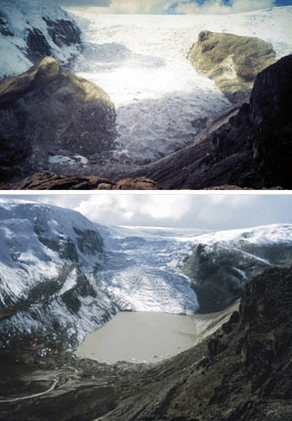
Glacier retreat in Cusco
Changes in the Qori Kalis Glacier, Quelccaya Ice Cap, Peru, are shown between 1978 (top) and 2002. The glacier retreat during this time was 1.1 km.
Photo credit: Lonnie Thompson

Slide 26
Impacts of glacier retreat on water
Source: Hüggel et al. 2003, Assessment of glacier hazards and glacier runoff

Slide 27
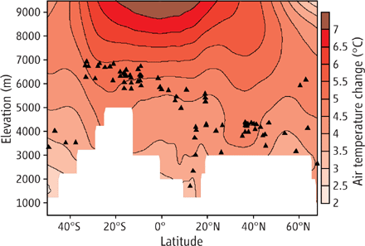
Warming in the American Cordillera 1990/99-2090/99
Source: Bradley et al. 2006, Threats to water supplies in the Tropical Andes

Slide 28
Percentage of Phinaya residents who express specific concerns

Slide 29
Glacier retreat, community, and issues (scale, valuation, control)
The mountains and glaciers provide the water which maintains the pastures.
The pastures support the herds which support the herders.
Individuals and households can move elsewhere, but they care for the herds and mountains for cultural as well as economic reasons.
When some individuals and households move, the community survives. When all move, it does not survive.

Slide 31
Livelihoods, migration and adaptation to climate change
How well do the following concepts fit together?
Livelihoods
Migration
Adaptation to climate change
For the herders in Cusco, who have experienced climate change for over a generation, they do not fit together well.
Other groups may face similar difficulties.

