Slide 1
Land Reform Migrations and Forest Resources Management in Zimbabwe
Prisca H. Mugabe, Krasposy Kujinga, Sunungurai D. Chingarande,
Charity Nyelele, Esteri Magaisa, Pascal Sanginga
Paper presented at “Migration, Rural Livelihoods and Natural Resource Management”
Hotel Entre Pinos, San Ignacio, Chalatenango, February 21-24, 2011

Slide 2
Research Partners
Chimanimani District farming communities (Nyabamba, Shinja, Chayamiti)
University of Zimbabwe
Institute of Environmental Studies (IES)
Department of Sociology
Department of Geography and Environmental Sciences
Southern Alliance for Indigenous Resources (SAFIRE)
Chimanimani District State Agencies
Environment Management Agency
Forestry Commission
Chimanimani Rural District
International Development Research Centre (IDRC)

Slide 3
Description of the territory
Chimanimani district, Manicaland province, eastern Zimbabwe
Three study sites representing a gradient of agrarian settlement models before and after national independence namely:
Nyabamba, a Fast Track Land Reform Programme A1 model area;
Shinja, a post-independence old resettlement area
Chayamiti, a traditional communal area

Slide 4
Location of study site

Slide 5
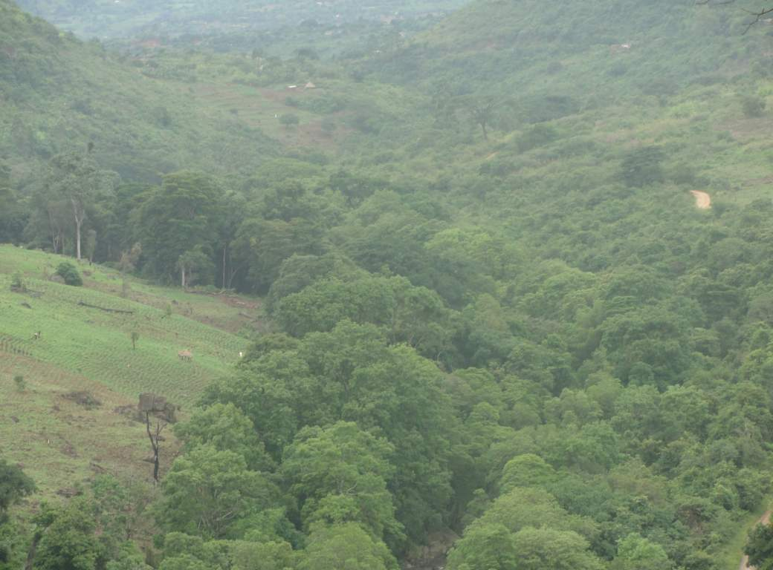

Slide 6
Livelihood strategies
Diversity of livelihood activities
Crop production: most common,
thus 88% of FTLRP migrants to Nyabamba immediately cleared forests in order to commence agricultural activities
Maize (staple) sunflower, finger millet, sugar beans, wheat, groundnuts, round nuts, cowpeas and sweet potatoes
Other livelihood activities: livestock production, gardening, piecework, well drilling, needlecrafts, vending, brick moulding, and beekeeping
Nyabamba migrants claim their welfare generally improved as a result of the land reform migration

Slide 7
Natural resource use
Harvesting of forest resources
80% households
firewood, building poles, timber, herbs, grass, fruits, mushrooms, and meat
household use or sale
Almost all the households relied on firewood for cooking and heating
20% of the migrants involved in making secondary products from forest raw materials
Nyabamba’s forest resources endowement
migrants’ false sense of perpetual abundance?
Only 2% of the migrants see forest conservation responsibilities as their own

Slide 8
Gendered use of forests
Women
collection of firewood herbs and wild fruits
64% of firewood collecters were women
Men
construction poles and firewood for sale
making processed forest products for sale or home use

Slide 9
CONTEXT/DRIVERS

Slide 10
Economic dynamics
Nyabamba rural to rural migrations derives from colonial land occupation of Zimbabwe of late 1800s -1980 wherein:
Indigenous people
forcibly relocated to segregated native reserves
coercively forced into labour on colonial settler farms
forced rural to rural, rural to urban migration
Native reserve lands: very restricted access to natural resources
75% of native reserves land was in the most arid and unfertile areas
Severe overcrowding and land degradation
Poverty in the native reserves was exacerbated by
poor access to natural resources, legal, social and economic barriers created by the colonial government
Communities used natural resources such as forests as safety nets against poverty

Slide 11
Environmental dynamics
Nyabamba: > 1000 mm rainfall per annum, 18-26 ⁰C in summer and 12-15⁰C in winter
Average : 750m above sea level
> 80% of land is on steep terrain, susceptible to erosion and land degradation
Ecoregion: montane forest-grassland mosaic (WWF, 2001)
Patches of indigenous Miombo vegetation against a landscape of exotic pine and wattle plantations
Choice of forests as the study natural resource domain: because of the abundance of natural and planted forests in Chimanimani, and the importance of forest resources
Before FTLRP, most of the forests in the district had remained fairly intact due to inaccessible location and legal protection
Threats to the forest resources due to resettlement: national implications due to wide range of timber and non-timber products
Zimbabwe, forests contribute 3% of GDP and employ 8% of the total labour force in the manufacturing sector (Mabugu and Chitiga, 2002)

Slide 12
Institutional framework
Formal institutions regulating use and management of forest resources
State agencies: Chimanimani Rural District Council, Environmental Management Agency, Forestry Commission
Minimal effectiveness due to constrained implementation capacity
Traditional leadership: most important forest governance structure
Thus, any efforts to improve the forest management practices in this area have to be centered around traditional leadership
Local and traditional rules and regulations for forest resources use were in place in Nyabamba
But, problematic enforcement
High demand for the resources, e.g., wet wood for construction and brick curing, stream bank cultivation for gardening
Implications for forest management interventions?

Slide 13
Agrarian reform regimes
Zimbabwe initiated Fast Track Land Reform Programme (FTLRP) in 2000
after unsuccessful post-independence (1980) land resettlement programmes
in response to socio-political pressures for faster land reforms
‘fast track’: spontaneously, very short period of time
A1 and A2 resettlement models
A1: villagized , individual residential and arable plots, communal grazing, woodlots, forests
similar to traditional communal lands but larger plots
aim: decongest communal lands, relieve land pressure in over-populated areas, extend and improve agriculture base in the peasant farming sector,
official target: landless peasants
predominantly rural to rural migration
stipulated A1 land sizes inclusive of the communal grazing area: 12-70 hectares depending on rainfall
FTLRP was implemented concurrently in all the provinces for socio-political equity

Slide 14
FTLRP process
Farm invasions or ‘jambanja’: spotentaneous initial occupation of white owned commercial farms by black masses
Official resettlement: using Government constitutional and legislative provisions
Invaded farm demarcation and designation to individual settlers
Offer letters: official recognition of settlers prior to official tenure
Issuance of permits and leases

Slide 15
Local and traditional knowledge systems
Local rules governed the preservation of sacred places in forests such as springs, mountains and rivers
Not allowed to cut down trees, start fires, draw water from natural sources using metallic and modern objects, and bathe at sacred sites
Sacred places importance:
believed to be ancestral spirits residence
sites for traditional spiritual ceremonials such as rainmaking ceremonies and rituals for appeasing the spirits.
Violating rules and regulations regarding the preservation of sacred places:
punishment by the headman
there was belief that the ancestral spirits would also punish violaters
Consequently, these areas were relatively intact

Slide 16
ANALYTICAL BACKROUND

Slide 17
Conceptual framework
Adapted Hugo’s model (1996): environmentally induced migration shaped by
predisposing conditions; precipitating events; constraining and facilitating factors; migration process, natural resource management and the policy response
Predisposing conditions, e.g., forest degradation, soil fertility depletion
e.g., In Zimbabwe communal areas resultant pressure on natural resources predisposes people to migration
A1 migrations mainly precipitated by prevailing national political and legislative environment
A1: “impelled” not “forced” migration, migrants retain some power to decide to migrate
But different from voluntary migration where migration is entirely migrant’s decision
A1 resettlement process: combination of complex multiple pressures
Policy and legislative arrangements by government precipitated mass migrations
Further policy provisions and refinements were made to aid the FTLRP after the migrations

Slide 18
Research hypotheses
Forest resources are important pull factors for migration into Chimanimani A1 resettlement areas.
Access to forest resources is gender and poverty related among Chimanimani A1 migrants.
Management of forest resources in Chimanimani A1 resettlement areas can be enhanced through improved local institutions and improved local capacity for forest management.

Slide 19
Natural resource management
Major concern : possible environmental degradation due to the influx of settlers to the resettlement areas
A1 settlers were drawn mostly from various communal areas, urban areas, growth points and mining areas, creating a cosmopolitan mixture of settlers,
‘mixed bag’ of A1 settler migrants had different experiences in institutionalised forest resource management
This scenario is expected to result in disintegrated natural resource management strategies and institutions whose effects on natural resource integrity could be detrimental
Most A1 migrants engage in non-agricultural livelihood strategies such as sale of fuel wood (Presidential Land Review Committee, 2003) which may result in overharvesting of trees in the forests
Requisite sharing of forests resources by immigrants in A1 resettlement areas could re-create some of the problems experienced in communal areas where the commonly shared land resources are often over-utilized and degraded

Slide 20
Key issues / Lessons Learned

Slide 21
Lessons: migration
Most important pull factor: agricultural land
Rejects research hypothesis that forest resources were the important pull factors
90% of the pull factors were directly related to the land
better farm land,
opportunity to own land
less populated area

Slide 22
Lessons: forest management
Forests were invaded and cleared for agricultural activities but there remained forest patches that provide a number of forest products and services
86% of the Nyabamba migrants had to clear the forest in order for them to commence farming
1-3 months to clear land for farming and residential
Over 70% reduction in forest cover of the area
Outside intervention should not be merely to stop deforestation but to facilitate change of attitudes about forests

Slide 23
Land cover change 2000-2009

Slide 24
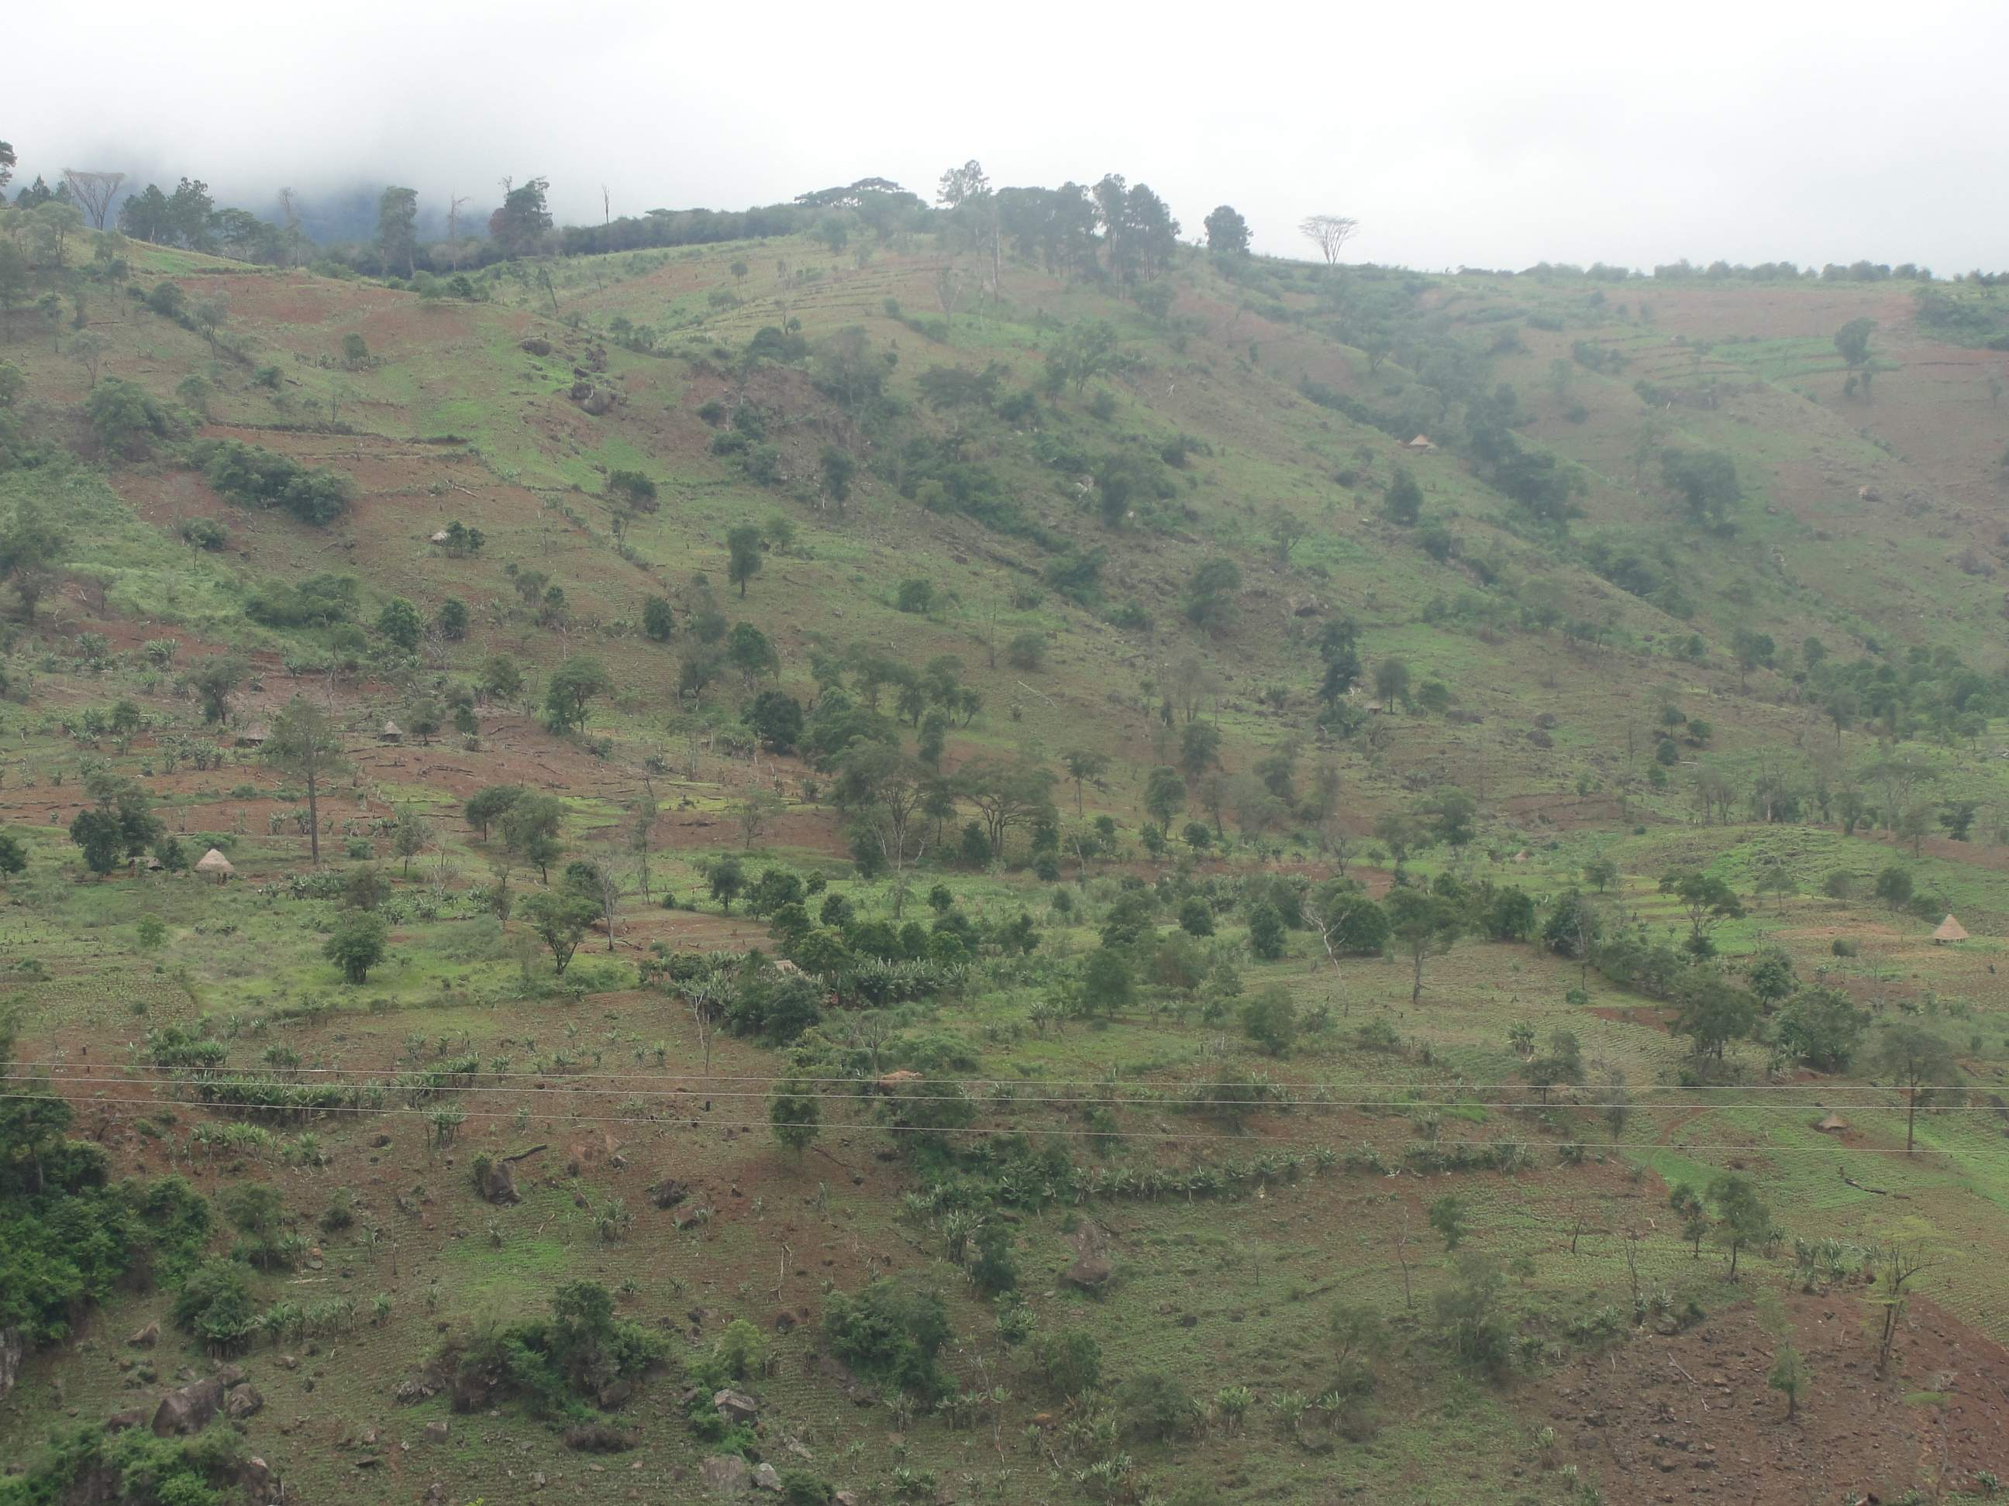

Slide 25
Lessons: gender
Women: majority land invasion participants
Offer letters:
69.2% only men’s
7.7% both the husband and wife’s names
14.4% only the wife’s name
Did FTLRP advance women’s empowerment causes?

Slide 26
Lessons: capacity building
Nyabamba migrants not oblivious to the degradation of their forests
Formulated community action plans
Benefited from NRM capacity building
legislation awareness workshop,
formed Environmental Management Committees,
afforesation,
sustainable bee keeping

Slide 27
Forest resources management
This...
....Instead of this

Slide 28
Future scenarios
Disparity in the access to resettlement land between men and women
This could accentuate poverty amoung the vulnerable gender groupings where agriculture is key livelihood
Gender disparities defeat FTLRP objectives of improving the livelihoods of migrants
Policy implication for the governance of forest resources is that there should be efforts to strengthen the traditional institutions which seem to be the more recognized.
A strong partnership of farmer communities, traditional institutions, government, non-governmental organizations, commercial timber producers and the Rural District Council should be supported by institutional and technical capacity building of communities.
Importance of provision of institutional capacity building for NRM in resettlement programmes. e.g., Environment Management Committees , local by-laws
Role of collaborative research

Slide 29
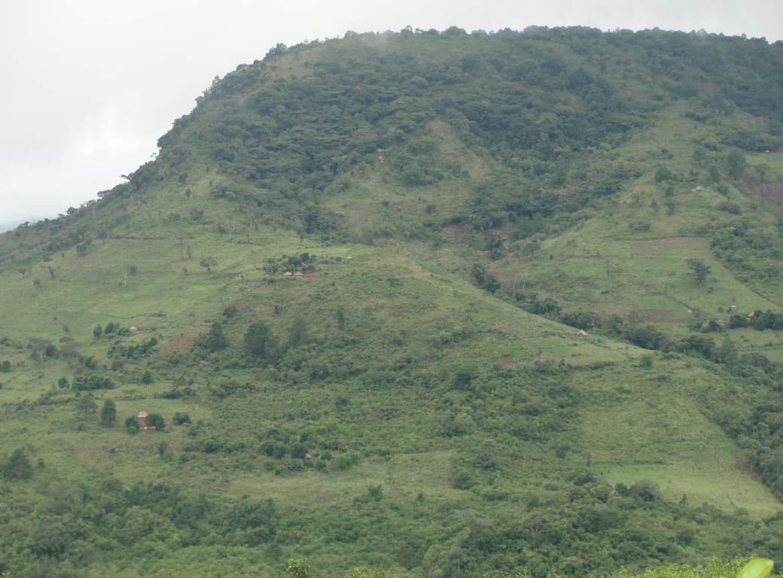

Slide 30
Thank you
Muchas Gracias

