Slide 1
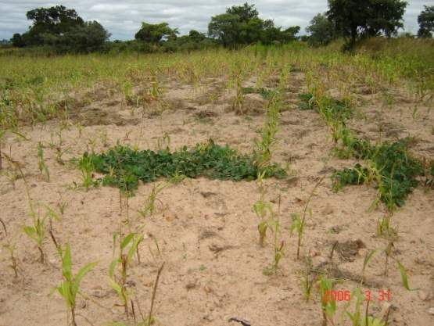
Lack of resilience in African smallholder farming: A time-bound source of conflict in the wake of climate change
Paul Mapfumo
Florence Mtambanengwe & Regis Chikowo
University of Zimbabwe
& SOFECSA/CIMMYT
Migration, Rural Livelihoods & Natural Resource Management Workshop – El Salvador 20-25 February 2011

Slide 2
Who is SOFECSA?
Soil Fertility Consortium for Southern Africa (SOFECSA) Multi-institutional, interdisciplinary consortium in 2005 to:
Develop and promote technical and institutional innovations that enhance contributions of integrated soil fertility management (ISFM) research and development to sustainable food security and livelihood options in Southern Africa
…..With a deliberate focus on improving the capacity of individual scientists and national agricultural research and extension (NAREs) institutions to conduct quality research at different levels… in Malawi, Mozambique, Zambia & Zimbabwe
Hosted by CIMMYT southern Africa in Harare, Zimbabwe

Slide 3
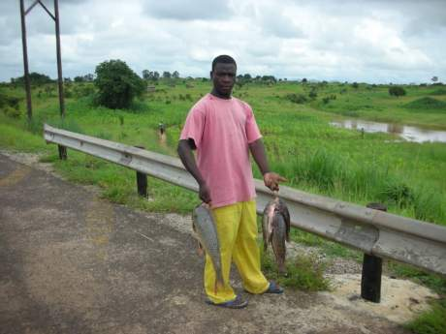
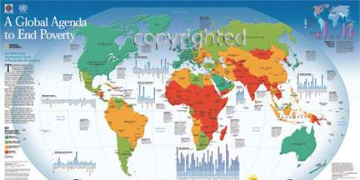
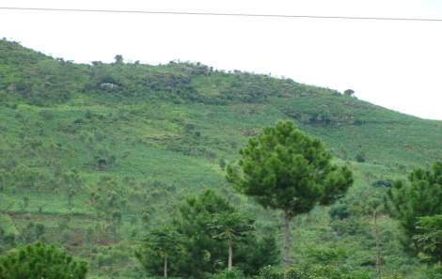
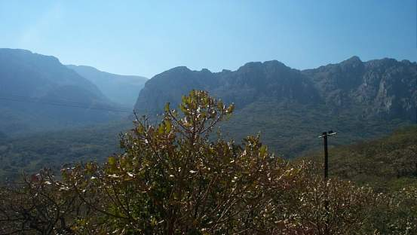
Reducing Poverty and Food insecurity remains the main Challenge for Sub-Saharan Africa
About 180 million Africans live on < US$1 each day
Livelihoods mainly based on extensive exploitation of natural resources—principally rainfed agriculture, forest and fisheries

Slide 4
The context of poverty in smallholder farming areas of Southern Africa
The poverty is ‘entrenched’:
Legacy of colonial architecture – smallholders (natives) not designed to participate in economic activities
Environmental marginality – limited livelihood opportunities (vulnerable groups often excluded from any emerging economic opportunities– mining, irrigation schemes, cash cropping)
Loss of dignity and self-respect – adopted and endorsed by current institutions (e.g. rural as punishment/icon of backwardness)
Loss of own languages and indigenous knowledge (challenge for capacity building)
Migration a default objective to escape rural poverty

Slide 5
The Project:
Lack of resilience in African smallholder farming: Exploring measures to enhance the adaptive capacity of local communities to pressures of climate change
Lead institution: University of Zimbabwe in Collaboration with SOFECSA and University of Wageningen
Funding: IDRC-DfID through the Climate Change Adaptation in Africa (CCAA) Program

Slide 6
Project objectives
The project sought to work with smallholder farmers in identifying and using improved farming technologies to adapt to climate change and variability
…and at the same time enhance the capacity of participating institutions and individual researchers to conduct climate change research & development initiatives with communities…
Mali
Ghana
Uganda
Tanzania
Zambia
Zimbabwe
Mozambique

Slide 7
Main characteristics of SA farming systems
Commercial versus communal
Smallholder farming systems are maize-based (80% land to maize year⁻¹), with strong livestock interactions
Frequent droughts and market volatility
High fertilizer-maize price ratios resulting from policy constraints
Declining farm sizes and draught animal ownership
Reduced labor supply due to HIV/AIDs
Falling migrant remittances (sometimes reversed)
Land locked countries versus stringent cross-boarder conditions: little trade and technology exchange
Low productivity and high vulnerability encourages risk-averse agricultural strategies at all levels (including slash and burn agriculture), especially among the resource-poor households and in marginal areas

Slide 8
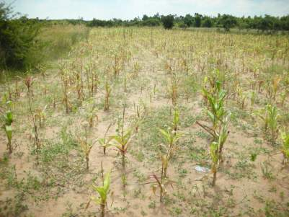
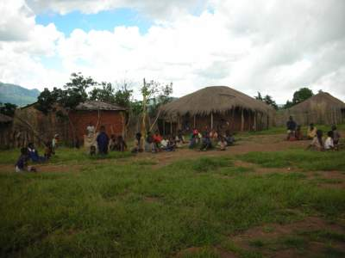
Major challenges for Southern Africa
Poor & declining soil fertility: smallholder production systems in Southern Africa are at rock bottom
Lack of resilience in the farming systems – limited market opportunities and livelihood options
Compounding effects of climate change and variability
Lack of capacity to deliver agricultural research and development – ‘A broken pipe’ scenario
Existence of ‘A maize poverty trap’

Slide 9
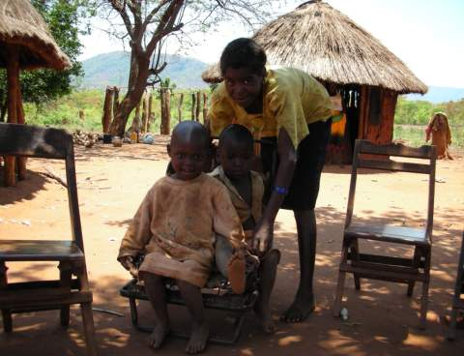
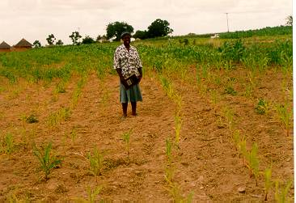
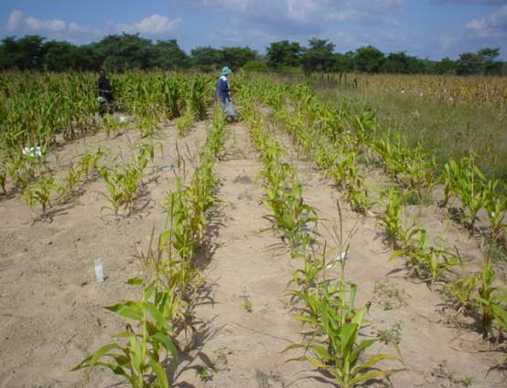
Empty Soils → Empty Stomachs → Poor Livelihoods
LAND &
CONFLICT
Climate change…extra load!!!
Rural Poverty
Poor & declining soil fertility
poor technology adoption
Loss of interest to participate
No capacity to invest even in low-input technologies
Poor market access
Unfavourable policies
Nutrient leaky systems
Low nutrient capital in soils
Poor access & availability of nutrient resources
Low & inefficient fertilizer use
Poor soil fertility: a social, economic and biophysical problem
The vicious cycle: A Poverty Trap

Slide 10
The project recognises that:
Farming systems in Africa are diverse and heterogeneous
One of emerging challenges of climate change and variability is that effects are particularly localised, requiring local solutions
There are NO ‘one size fit all’ or silver bullet technologies
Need for participatory action research to generate ‘best-fitting’ innovations

Slide 11
Methodology
Participatory action research
Farmer learning centres
Participatory modelling
Innovation systems approaches
Reflection
Monitoring
Monitoring
Reflection
Planning
Action
Action
Action
Problem
Solution

Slide 12
Key findings

Slide 13
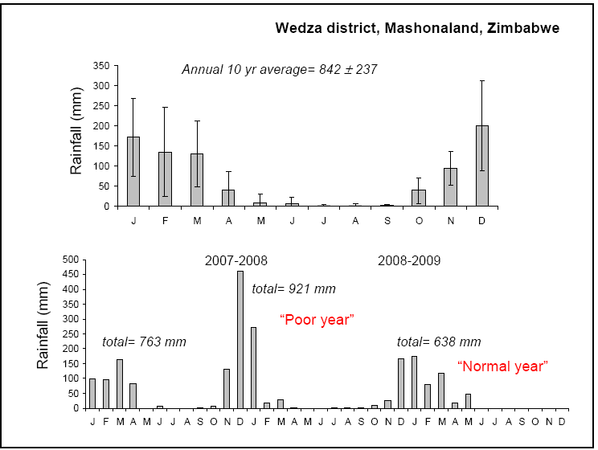
Rainfall variability as a major source of vulnerability

Slide 14
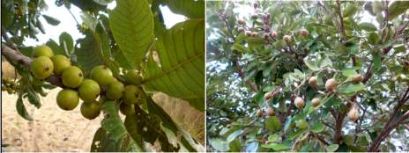
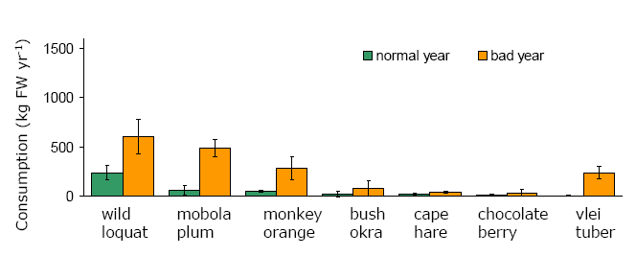
Non-Timber Forest Product Consumption in Wedza Zimbabwe
NTFP contributed ~20% of energy
intake for wealthier farmers
•And ~40% of energy intake of
poorer farmers
Often a source of conflict for communities
Mazhanje
Hacha
Matamba
Derere
Tsuro
Tsubvu
Tsenza

Slide 15
Smallholders only food secure 4 months in a year in Mozambique
Month | Food sources (no legumes)
January | Vegetables, mangoes, cassava leaves
February | Vegetables, pumpkins, cassava leaves
March | Green mealies, early maize, pumpkins
April | Green mealies, early maize, sweet potatoes
May | Maize, sweet potato, small grain cereals, madhumbe
June | Maize, cassava, sorghumcereals, madhumbe
July | Maize, cassava, small grain cereals, madhumbe
August | Maize, cassava, banana, small grain cereals, madhumbe
September | Tree roots, honey, mazhanje,
October | Tree roots, honey
November | Honey, mangoes
December | Honey, mangoes, wild fruits, vegetables

Slide 16
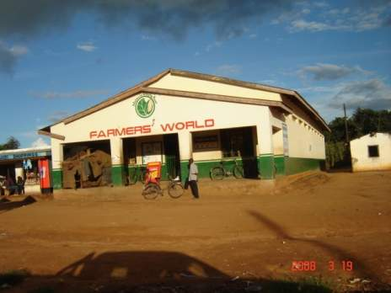
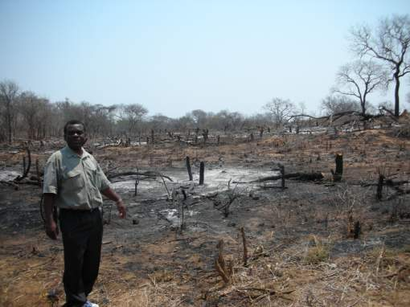
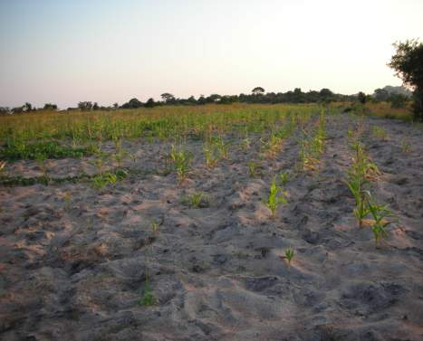
Contemplating migration?
Major sources of vulnerability
Poor soil fertility,
poor infrastructure,
lack of access to markets climate change & variability
breakdown in social safety nets

Slide 17
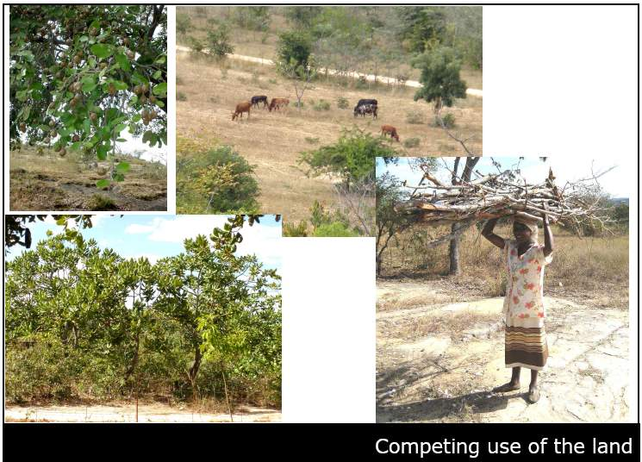
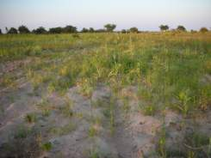
A degrading natural resource base: ‘Wrong decisions versus difficult choices’

Slide 18
Glaring threats!
Failure to attain food-self sufficiency at household, community and national levels
  Diminishing diversity of crop types/varieties & food sources
‘Tailored’ culture of dependence on aid and relief food sources
  Undermining of traditional social safety nets
General lack of ‘local empirical content’ in the conceptualisation and design of research and development initiatives
  General neglect of locally generated knowledge & products in development (in favour of the cut and paste solutions)
Migration to unknown/unplanned destinations

Slide 19
Sources of vulnerability & conflict
Remittances –who leaves first (farm development cycle (education as a driver for bubbling out of poverty)
Degrade and survive now (e.g. charcoal)
Traditional values, norms and regulations for resource management giving way
Collapse of safety nets (power struggles, disintegration of extended family – rise of capitalistic tendencies as a shock established (loss of resilience)
Declining natural resource base
ESAP

Slide 20
African smallholder farmers are still heavily dependant on indigenous climate change indicators in their decision making
What to crop types and cultivars to grow and when?
How to manage food stocks at household and community levels?
How to participate in trade and resource-sharing arrangements
How to allocate land resources in the medium to long term
How to manage investments in livestock (key source of insurance in most communities)
When to trigger local disaster response mechanisms

Slide 21




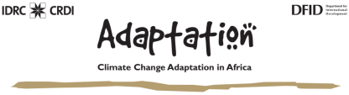
SOFECSA Learning Centres
…Exiting the ‘Maize Poverty Trap’ through Integrated Soil Fertility Management (ISFM)…
University of Zimbabwe
…Learning with communities to adapt to climate change and variability…
Notes:
21

Slide 22

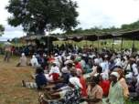
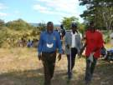

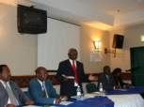
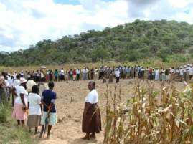
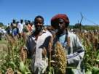

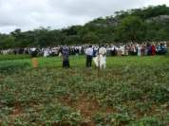
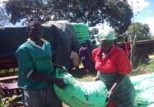
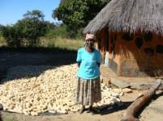
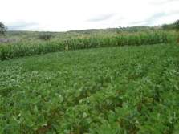
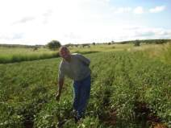
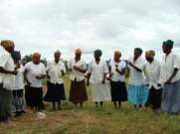
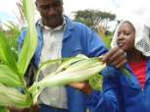
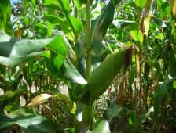

Mobilizing smallholder farmers for collective action to increase productivity and access to markets
Employing integrated agricultural research for development (IAR4D) approaches
Enhancing capacity of farmers to adapt to climate change & variability
Integrated Soil Fertility Management-
ISFM- as an entry point
Legume-cereal rotations
Cereal/legume intercrops
Increased mineral fertilizer use
Matching farmer resource endowments
Combining organic & mineral fertilizers
Appropriate crop types & varieties
Increasing resilience
Building Innovation Platforms
Communities
Local leaders
Service providers
Policy makers
SOFECSA in Zimbabwe
Crop diversification
Innovating with
communities
Introducing The Learning Centre approach
Reaching the vulnerable
Fertilizers – ‘a must’
Increasing productivity
Communicating through drama & song
Stimulating development
Household food security
Increasing availability of farm resources
input& & output market opportunities
Off-farm livelihood opportunities
Building Capacity
Escaping the ‘maize poverty trap’

Slide 23
Experimenting with farmers
Managing variability - enhanced precision

Slide 24
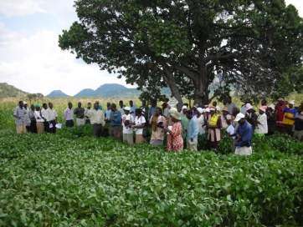
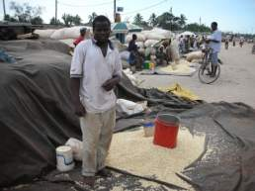
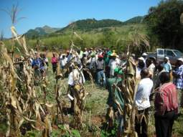
Empowering farmers to access input resources and participate in markets
Yield benefits of collective action: timely access to appropriate types of inputs

Slide 25
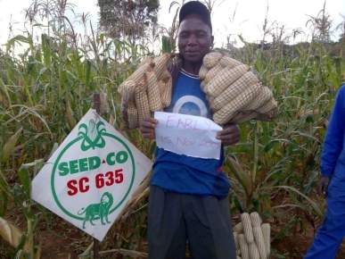
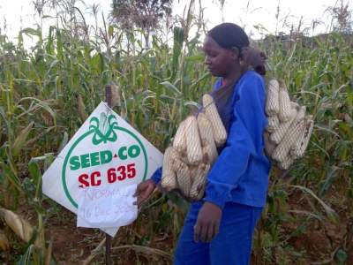
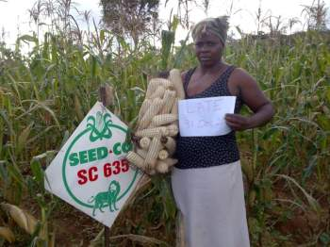
Enhancing farmers’ capacity to respond
Yield effects of appropriate planting time in response to rainfall

Slide 26
Putting ISFM to work according to farmer circumstances
Resource endowed
(3 →>6 t ha⁻¹)
Intermediate
(1.5 →>3 t ha⁻¹)
Resource constrained
(<1 → >2 t ha⁻¹)

Slide 27
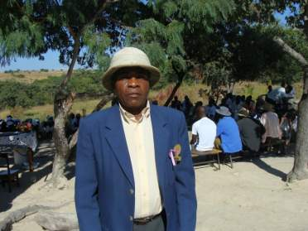
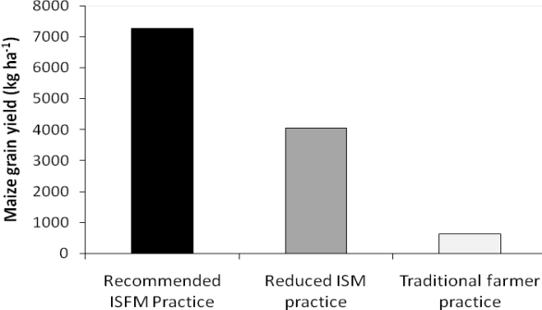
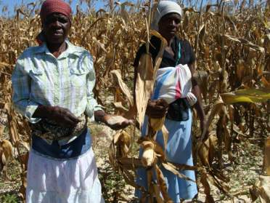
Strengthening local institutions to revitalize traditional social safety nets
Success with the Zunde raMambo concept in Nyahava, Makoni district
Realization of high yields under ISFM technologies convinced farmers to participate

Slide 28
Adaptation options prioritized by communities?
Comprehensive capacity building programs for farmers & their service providers
Generate surpluses during favourable seasons to offset future deficits
Empower communities and service providers for collective acquisition of inputs and marketing of produce
Increasing access to production resources & food by vulnerable groups
Equip policy makers with ‘locally relevant’ evidence-based scientific facts for decision making
Support platforms for information & knowledge sharing …main pathway for information flow is farmer-farmer

Slide 29
Moving towards production-to-marketing models through innovation platforms
‘External’ (free) Inputs from:
Government
  NGOs
  Research
  Remittances
Natural Resource Base
1
Production
Processing
2
‘Internal’ Inputs from:
Farmers own seed reserves
Direct markets purchases
  Credit schemes by Govt./NGOs/Agro-Financing institutions
  Contract farming schemes
Packaging
Consumption
Storage
Institutions & Policies
Marketing
3
4

Slide 30
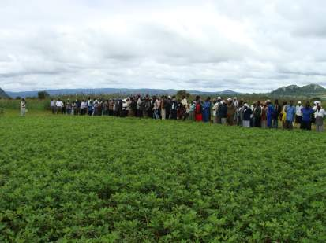
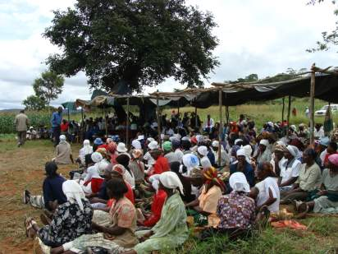
Emerging issues
Employing ISFM to increase crop productivity and farmer market participation resolved challenges related to land tenure, social safety nets and competing land uses
Climate change impacts differentiated by gender and farmer resource endowment among other factors
Capacity building initiatives that build on indigenous knowledge enhance farmer decision making
Co-learning with communities leads to joint development of ‘best-fit’ adaptation options, activating internal for mechanisms adaptation
PAR enabled communities and service providers for collectively manage natural resources

Slide 31
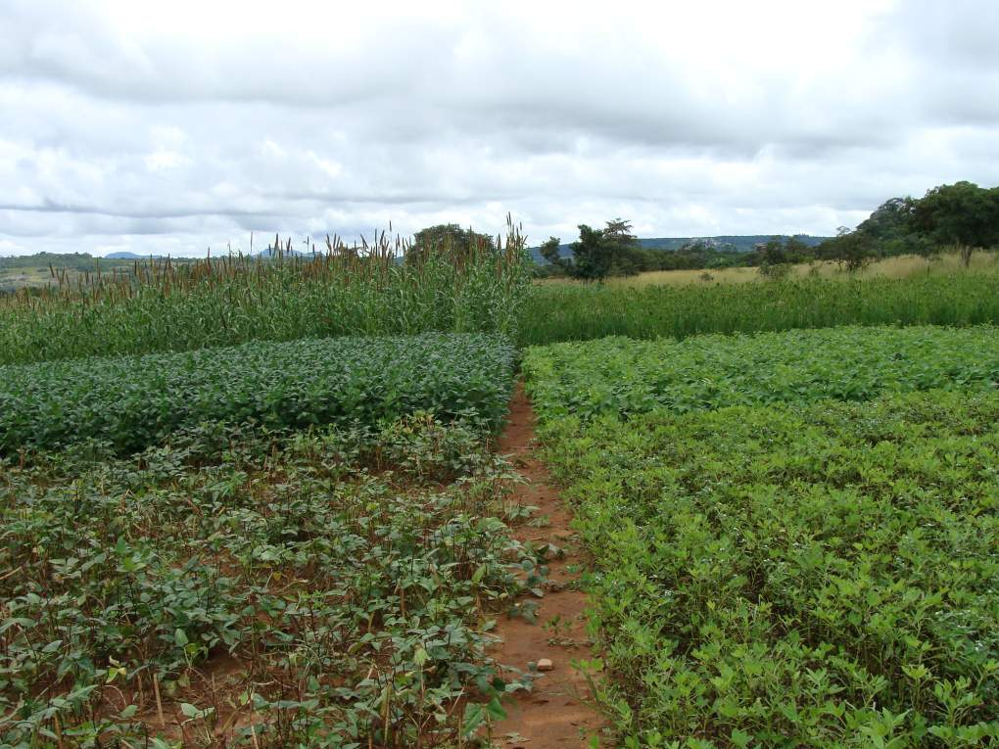
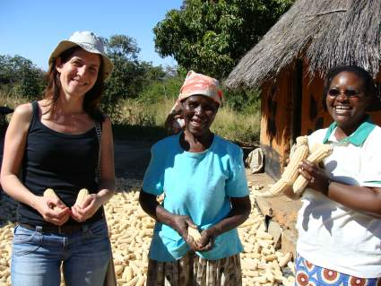
Funding by the DFiD-IDRC- Climate Change Adaptation in Africa (CCAA) program is highly acknowledged
Thank You

